Slide 1





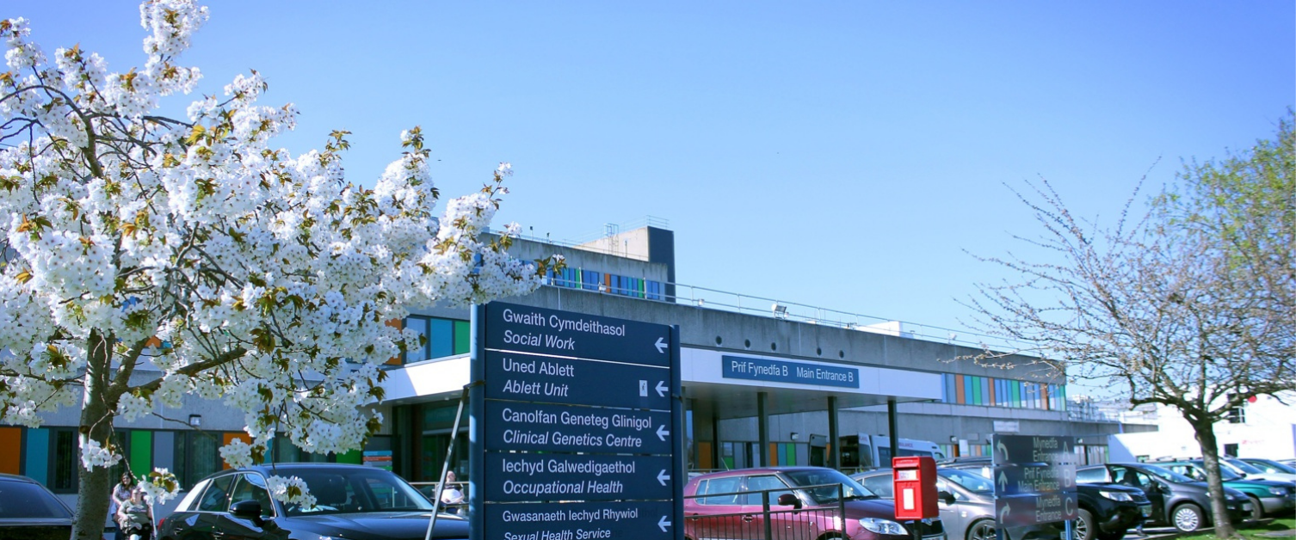

FY1-2
HANDBOOK
DR JESSICA LACOURSE
GLAN
CLWYD
A GUIDE TO YOUR ROTATION

Slide 2
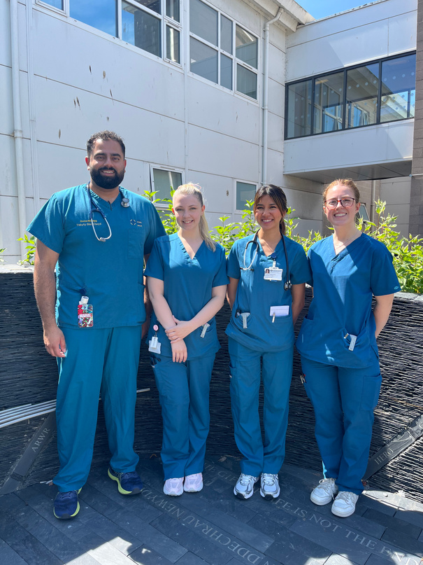
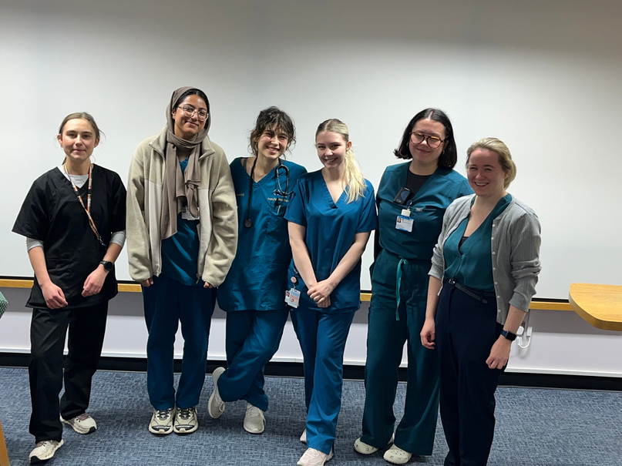
CONTENTS
Accident & Emergency ...................................................................................................................................................................Page 3
Anaesthetics ...................................................................................................................................................................................................Page 4
Acute Medical Unit .................................................................................................................................................................................Page 5
Breast Surgery .............................................................................................................................................................................................Page 6
Cardiology ..........................................................................................................................................................................................................Page 7
Dermatology ...................................................................................................................................................................................................Page 8
Endocrinology ..............................................................................................................................................................................................Page 9
ENT / Max-Fax ..............................................................................................................................................................................................Page 10
General Practice .........................................................................................................................................................…..........................Page 11
General Surgery ........................................................................................................................................................................................Page 12
Geriatrics .............................................................................................................................................................................................................Page 13
Obstetrics & Gynaecology ..........................................................................................….........................................................Page 14
Orthopaedics .................................................................................................................................................................................................Page 15
Paediatrics .........................................................................................................................................................................................................Page 16
Community Paeds ..........................................................................................................................…....................................................Page 17
Psychiatry ...........................................................................................................................................................................................................Page 18
Renal ...........................................................................................................................................................................................................................Page 19
Respiratory .......................................................................................................................................................................................................Page 20
Stroke ........................................................................................................................................................…...........................................................Page 21
FY1 Medical On Calls ..........................................................................................................................................................................Page 22
FY1 Surgical On Calls .........................................................................................................................................................................Page 23
Must Knows .....................................................................................................................................................................................................Page 24
ACKNOWLEDGEMENTS
A huge thank you to the FY1/2s who have helped to make this booklet, this wouldn’t have been possible to do without your support.
Dr Ahmed Awan for ED & Breast Surgery
Dr Aqilah Musa for Dermatology & Respiratory
Dr Berin Demren for Cardiology & Paediatrics
Dr Caitlin Baillie for AMU
Dr Iman Selim for Endocrine
Dr Lucy Green for Anaesthetics & Community Paeds
Dr Rachel Horne for ENT / Max-Fax
Dr Janelle Chicilo for Psychiatry
Dr Rhehanna Gilani for GP
Dr Donia Abdel-Aziz for O&G
Dr Magi Tudur for assisting in the Welsh translation

Slide 3
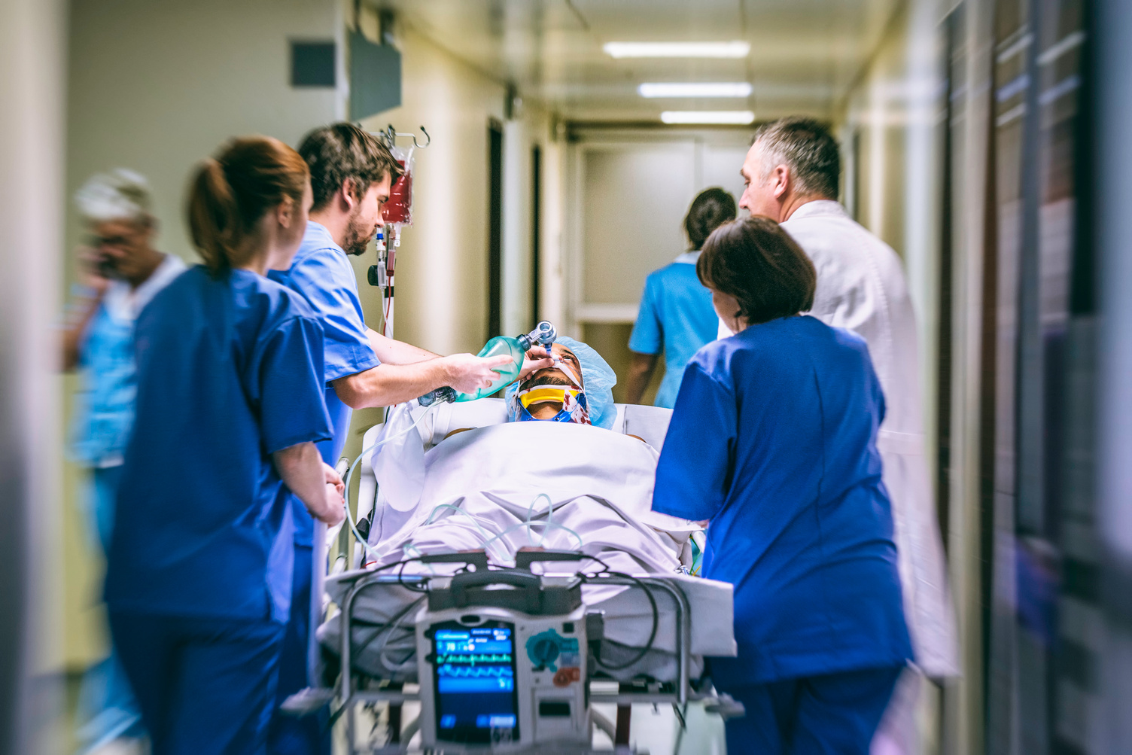
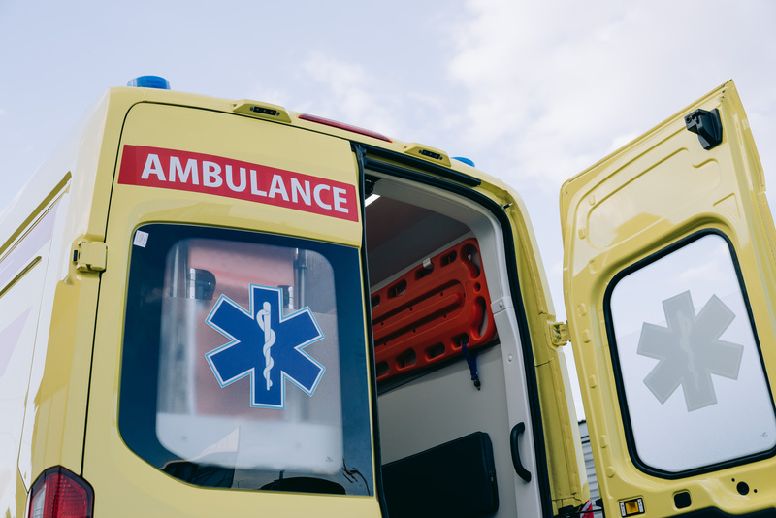
A&E
Glan Clwyd
Pay Band 1A
8AM-4PM or 1PM-9PM ED
What is your responsibility?
As an FY1 you will have a lot of jobs! Your most common responsibilities will be:
Reviewing patients
Discussing cases with a senior
Cannulating
Taking bloods
Making referrals
Requesting imaging
Attend weekly departmental teaching
How does ward round work?
This post is supernumerary, meaning you will be well protected, encourage to learn and given the opportunity to do so in the course of your work.
You will either be doing 8-4s (majority of your days) or 1-9 (on certain Wednesdays and/or Fridays). Additionally, you will be rota’d to work 1 in 3 weekends, but these are still only 8 hour shifts.
Being ED, there is no ward round. However, if working the 8-4 shift, you will be expected to arrive on time for morning handover at 8am. Afterwards, you will begin the day by choosing waiting patients (usually in time order) to review. This includes history, examination and initial investigations. You then are expected to discuss your findings and initial management plan with an appropriate senior (Middle-grade or Consultant) to determine the most appropriate next steps in the management of your patient(s).
If not sending the patient home (with or without some sort of treatment in ED) then they are likely for admission to hospital so you will need to contact the appropriate specialty on-call team who is best suited to continue treating the patient for their presentation to hospital.
At 4pm, whether finishing shift or not, you are to attend evening handover. If finishing for the day, it’s encouraged to have your patients sorted out, but if need be, you may handover jobs prior to leaving.
Conditions to Know
The most common presentations are:
Fall
UTI
IECOPD
PE
ACS
Ensure competence with CXRs, ECGs & Blood gases.
IMPORTANT BLEEPS
DVT Nurse - 4472
Stroke Nurse - 3643
ECG - 4423
EPIC (ED Lead Cons.) - 6277
Medical SHO on-call - 1502
Surgical SHO on-call 1511
3

Slide 4
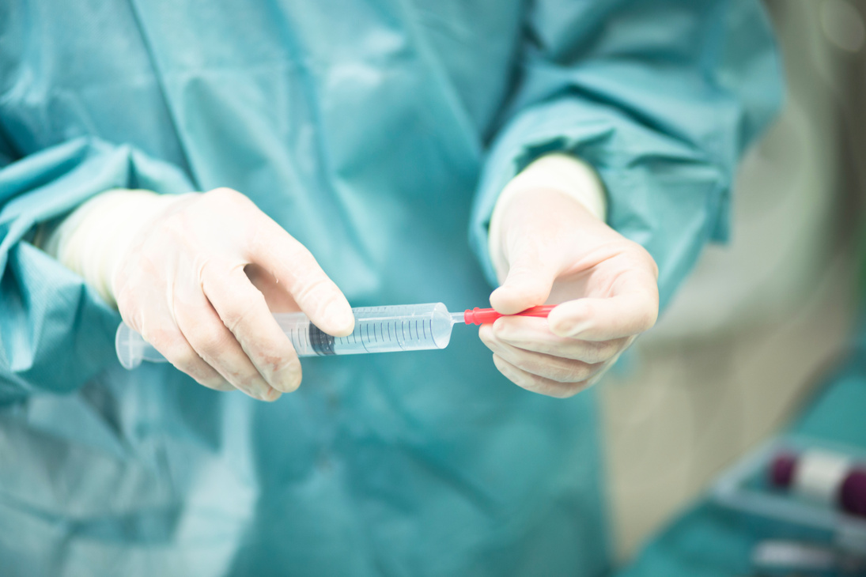
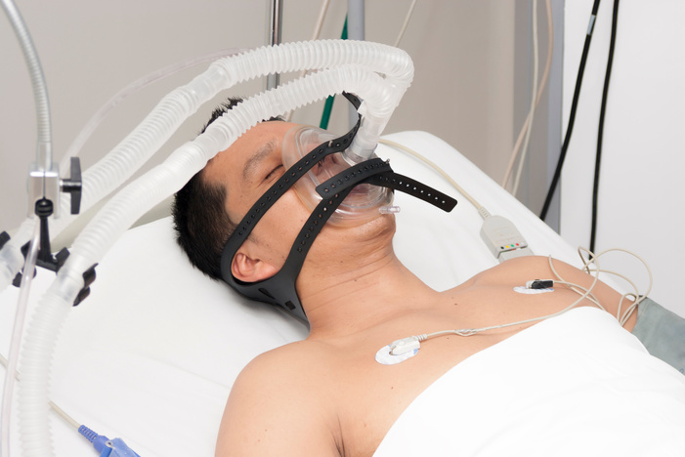
ANAESTHETICS
Glan Clwyd
Pay Band 1A
8AM-5PM / 6PM ITU/THEATRE
What is your responsibility?
As an FY1 you have plenty of learning opportunities and a chance to practise skills. Some jobs you can get involved with are:
Reviewing patients in ITU
Pre-Operative Assessments
Developing Airways Skills ( LMAs / Bag Valve Mask / ET tubes)
Cannulas
How does ward round work?
For the rest of your rotation you will spend your time in theatres. You will see the theatre you have been allocated to for the day on the rota.
When you arrive, get changed and head to your allocated theatre. There is a board with the theatre lists in DOSA where you will be able to see where the patients for the day are. Join the anaesthetist to complete the pre-operative assessments then go back to theatre to begin the list. Once you get more confident you can help with these.
You will also be allocated for some long day shifts (1pm-1230am) where you will be in emergancy theatres. When you arrive go to Theatre F to meet the anaesthetists you will be working with.
For 1 week every month you will be allocated for ITU. Handover starts at 830am every morning. Once handover is finished you will divide into 2 groups. ITU North and ITU South (you will tend to stick to the same area all week depending on staffing levels). Depending on the consultant of the week you will begin to see patients independently. There are ward round proformas which through the important aspects that you need to cover. At some point in the morning the consultant will then do a ward round seeing all the patients.
After ward round you will complete the jobs for the day. Get involved: there is plenty of opportunity to perform and observe skills (NGs/ arterial lines / central lines / extubation)
If the unit isn’t too busy you can ask to shadow other members of the team to see referrals in resus / wards and go to arrest / met calls.
Conditions to Know
ITU has many conditions and can be very complex. The most common presentations are:
Severe Pneumonias
Post Rosc Cardiac Arrest Patients
Single Organ Failure
Post Operative Patients
Patients requiring vasopressor support
IMPORTANT BLEEPS
Anaesthetist On Call (Theatres) - 1500
On Call (ITU) - 1505
AIT - 4495
DOSA - 844 102
4

Slide 5

ACUTE MEDICINE
Glan Clwyd
Pay Band 1B
9AM-5PM AMU
What is your responsibility?
As an FY1 your main responsibilities are:
Reviewing patients on ward round
Actioning jobs from ward round - this may involved:
Referring/liaising with other specialities (incl. medical specialities
Request imaging, and discussing with radiology
Discussions with microbiology
Reviewing a deteriorating patient
Reviewing ECGs
Bloods/cannulas (although the phlebotomists visit AMU every morning, and the more senior nurses are very helpful with extra bloods and cannulas)
TTOs/DALs
How does ward round work?
Jobs which can have a lower priority are doing routine referrals to other medical specialities as they are unlikely to be seen in one day anyway.
Another thing which you need to consider is how urgent discharge letters need to be done in the day. If a patient needs a package of care reinstated by a certain time of day then their discharge may need to be done earlier in the day vs. a patient going back home (but the nurses will be able to guide you with this).
AMU is a very busy unit, in which you will learn a lot of medicine, but if you are unsure there is always someone available to provide advice. .
AMU is a 28 bed unit, and depending on staffing levels you will be responsible on average for between six to ten patients.
For approximately half of the week you will be accompanied by a consultant on ward round and on the other days, you will be expected to independently review patients, but there is always a senior around to ask for advice if you are unsure. Sometimes there will also be patients to be seen on PTWR, and rarely needing to be clerked as well.
As patients in AMU tend to be more acutely unwell, often there are many jobs needed for each patient, so prioritisation of jobs is key.
Jobs which should be done urgently include organising scans for acutely unwell patients and doing ABGs if there is an increasing oxygen requirement.
Conditions to Know
IMPORTANT BLEEPS
The most common presentations are:
CAP/IECOPD/Asthma exacerbation
ACS/Decompensated HF
Sepsis
AKI
UGI Bleed
Oncological emergencies/complications
Basically any medical condition!
ECG - 4423
AIT - 4495
ITU - 1505
Acute oncology nurse - 9911
5

Slide 6
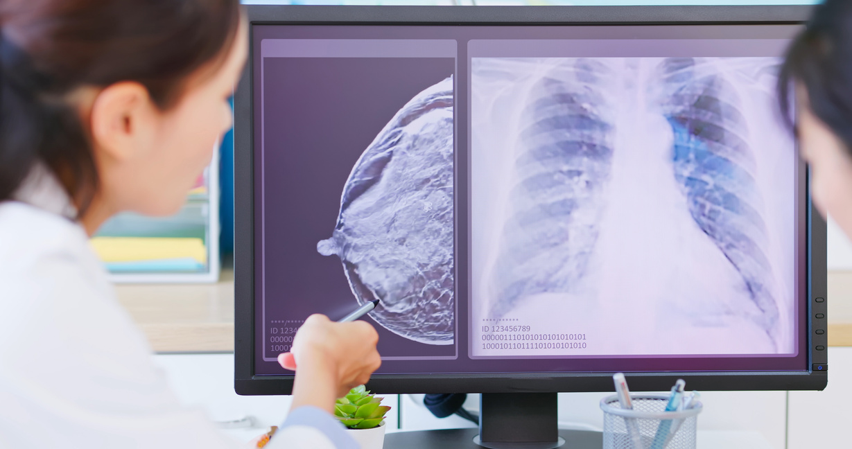
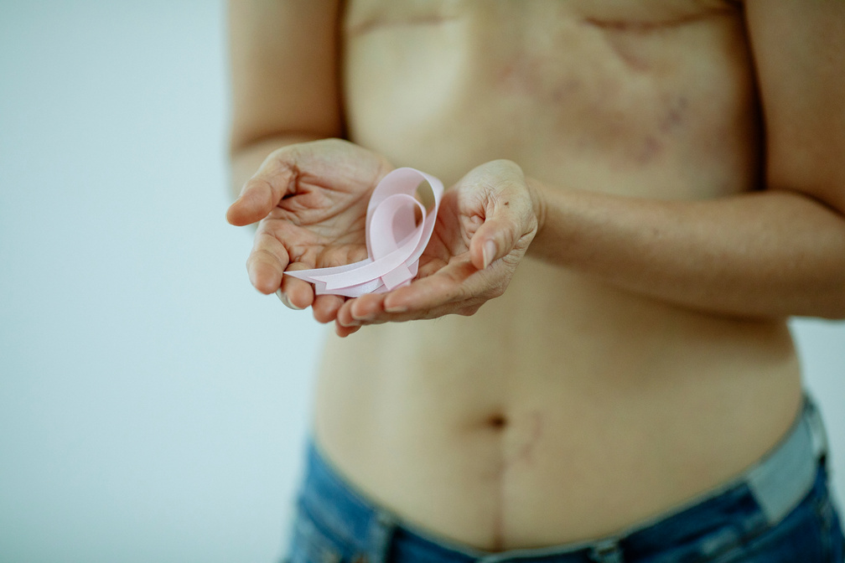
BREAST SURGERY
Glan Clwyd
Pay Band 1A
8AM-4PM WARD 19A
What is your responsibility?
As an FY1 you will have a lot of jobs! Your most common responsibilities will be:
Surgical theatre time (~ 3 days per week)
Writing drug charts for surgical patients on the morning of their operation
Attending Breast MDT on Mondays
Reviewing patients when asked in SDEC or elsewhere
Reviewing patients on the ward (though not often)
Cannulating
Taking bloods
How does ward round work?
This post does not have much in the way of ward work. The majority of your time will be spent in theatres (almost always Tuesdays, Thursdays and Fridays). On the morning of surgical days, you will be expected to arrive to DOSA to write up the drug charts for the patients on the list for that day. Apart from theatre days, your time is often your own. There is an expectation that you attend Breast MDT on Monday afternoons. IF there are any inpatients, then you may round on them (this is rare as the vast majority of patients are day cases). If you so wish, you may attend Breast clinics on non-theatre days in discussion with appropriate senior/supervisor. Finally, you are expected to answer bleeps if/when a patient review is needed in SDEC or elsewhere in the hospital.
Breast Surgery is a great rotation as it is not massively busy and has great teaching opportunities with lots of theatre exposure.
Make the most of this relatively relaxed rotation by pursuing academic interests (e.g.., audit/QI).
N.B. You will be part of the general surgery on-call rota as well 2 weekends in the rotation where you will cover the Vascular ward.
Conditions to Know
Breast has many conditions and can be very complex. The most common presentations are:
Breast cancers
Breast abscess
Surgical procedures (WLE, Mastectomy)
IMPORTANT BLEEPS
Surgical SHO on-call - 1511
Surgical SpR on-call - 1508
Medical SHO on-call - 1507
Medical SpR on-call - 1503
Cannulation team (OOH) - 4974
DOSA - 844 102
6

Slide 7
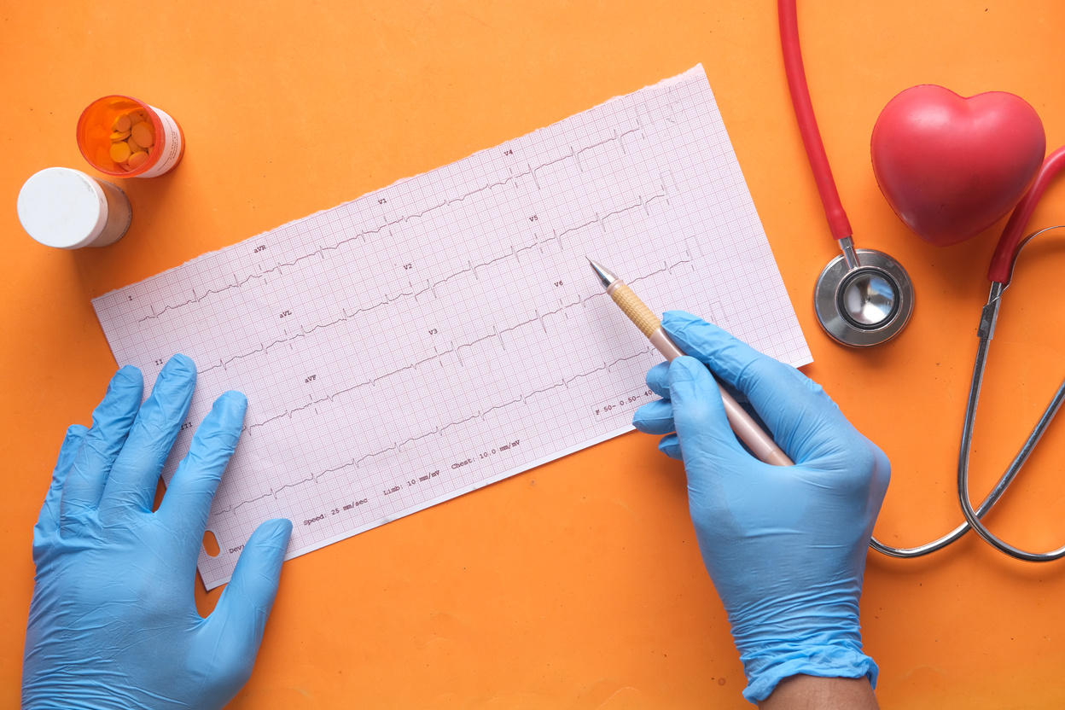
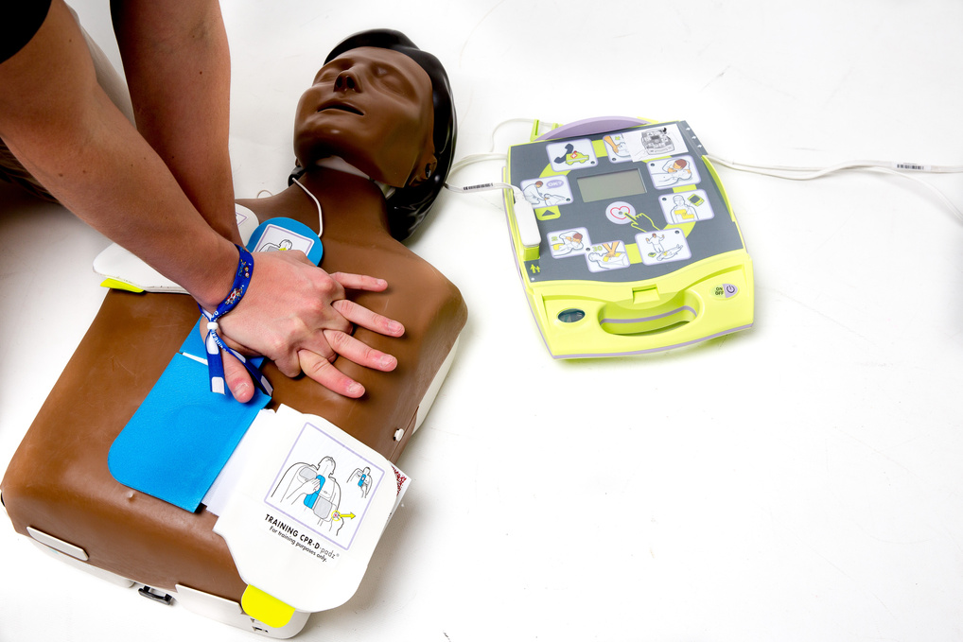
CARDIOLOGY
Glan Clwyd
Pay Band 1B
9AM-5PM WARD 4
What is your responsibility?
As an FY1 you will have a lot of jobs! Your most common responsibilities will be:
Reviewing patients
Rewriting drug charts
Cannulating
Taking bloods
Making referrals (including referrals to LHCH)
How does ward round work?
Ward 4 works a little differently to the rest of the medical wards. It is technically both a cardiology and a general medicine ward. As the FY1 you with the rest of the team will be responsible for all 25 patients on the ward regardless of what specialty they are under.
The ward round for cardiology patients usually starts after board round which is at 10am. In this board round the ward sister will go through the list of patients on the ward and discuss their ongoing management and further plans briefly with the attendance of consultants, OT and PT. The ward round which starts after this is divided into two; one done by the on-call cardiology consultant of the week who reviews all the new patients and one round done by the cardiology consultant of the day who reviews the “old” cardiology patients. One of the juniors will usually go with each consultant on these ward rounds. While the cardiology consultant of the week will almost always come to review the new patients, you will often need to review the old patients by yourself.
Once the cardiology ward round is done you might need review the patients whose parent teams did not come to round them. While this might sound tricky, over time you will get an idea of which teams are more likely to come review their patients and prioritise those who are less likely to be seen.
I would advise to use your time between 9 and 10am wisely to either starting doing jobs you know will need to be done later such as doing bloods, chasing referrals, discussions with microbiology or start reviewing the non-cardiology patients on the ward to make sure you finish on time.
Conditions to Know
Cardiology has many conditions and can be very complex. The most common presentations are:
Heart Failure
ACS
Arrhythmias (Tachy-brady, SVT, heart blocks, etc.)
Pericarditis
Myocarditis
Infective Endocarditis
IMPORTANT BLEEPS
Heart Failure Nurse - 4555
ECG - 4423
Echo - 4249
Cardiac Physiology - 4249
Cath lab - 845480
CCU - 844086
7

Slide 8
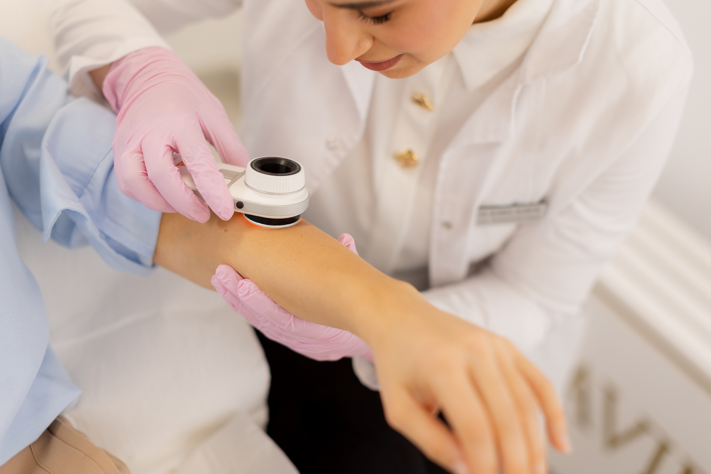
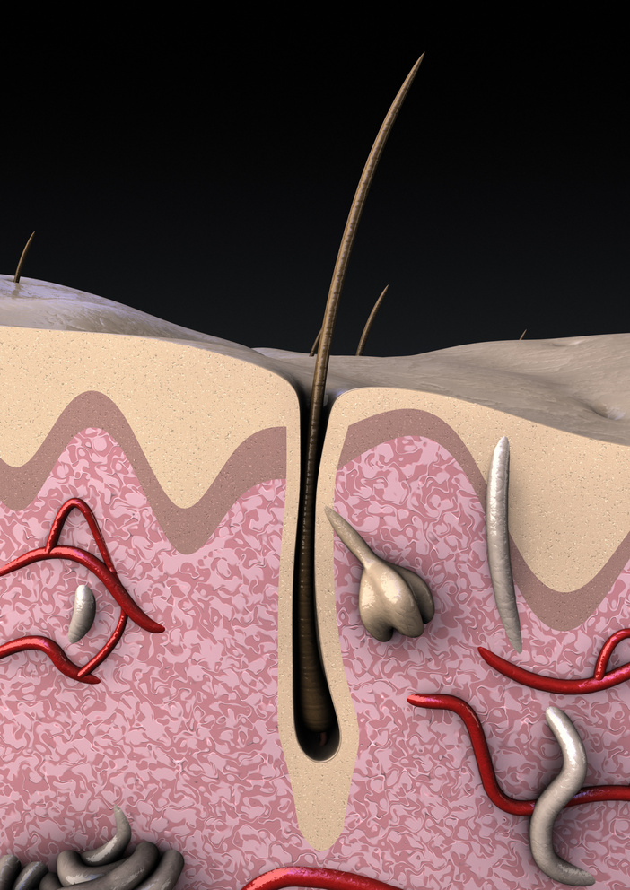
DERMATOLOGY
Glan Clwyd
Pay Band 1B
9AM-5PM OPD & OFFICE
What is your responsibility?
FY2
ONLY
This is an FY2 only placement.
The dermatology role typically runs from 9 am to 5 pm and mainly involves both clinics and referrals.
Outpatient clinics: Seeing patients and performing consultations.
Referrals and inpatient reviews: Assessing and managing patients referred by other teams, providing specialist input for inpatients, and liaising with other medical teams, as dermatology does not have its own ward.
Non-clinical work: Time is set aside for administrative duties, audits, and quality improvement projects (QIPs).
When not working in dermatology, you also participate in general medical on-call shifts as part of the hospital rota.
How does ward round work?
Each day, a different consultant is on call, and the timing of ward rounds varies depending on their schedule. At the start of the day, you check for any new referrals — these can come through CITO or via the secretaries’ office. If there are referrals, you and the registrar will review the patient first to gather background information and perform an initial assessment.
When the consultant is ready to conduct their ward round, they will be joined by you, the registrar, and a specialist dermatology nurse to review the patient together, discuss findings, and plan further management.
Conditions to Know
As an FY2, you will need to know
Melanoma
Squamous cell carcinoma
Basal cell carcinoma
Actinic keratosis
Seborrhoeic keratosis
Eczema
Psoriasis
How to describe a rash/lesion
Dermatological emergencies
Leg ulcers
IMPORTANT BLEEPS
There are no specific “important bleeps” in dermatology, but as you’re usually the only person in the department with a bleep, most hospital staff will contact you when they need to reach dermatology.
8

Slide 9
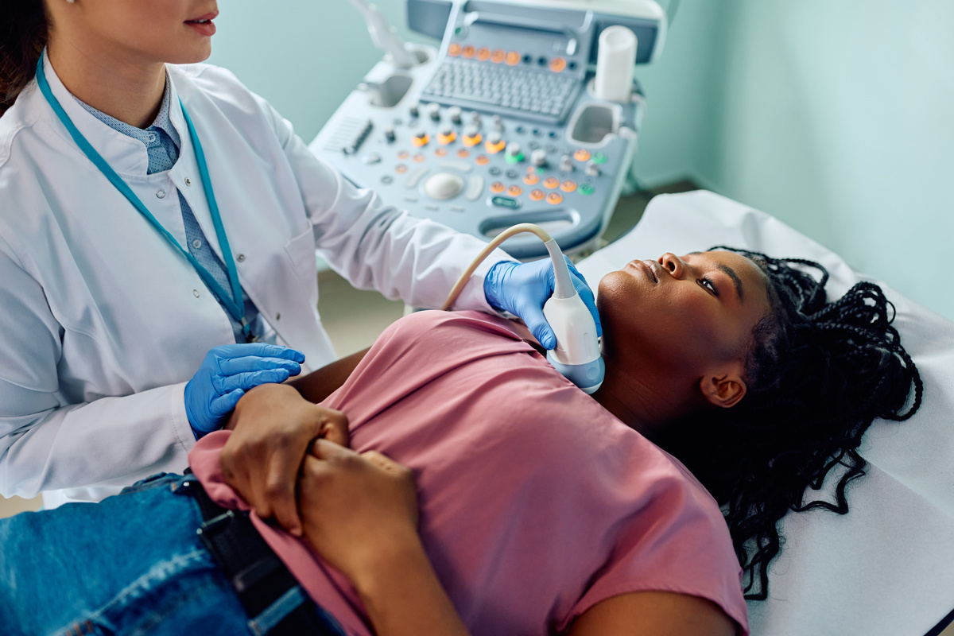
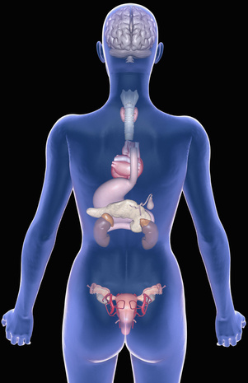
ENDOCRINOLOGY
Glan Clwyd
Pay Band 1B
9AM-5PM WARD 10
What is your responsibility?
As an FY1 you will have a lot of jobs! Your most common responsibilities will be:
Reviewing patients
Rewriting drug charts
Cannulating
Taking bloods
Making referrals
How does ward round work?
On some days you will see your patients independently and on other days you will see them with the consultant. The consultants have not been consistently the same on this ward but there should be 2 or 3 consultants.
There are also outlier patients on other wards when a consultant has done an on call shift beforehand which need to be seen. There are some respiratory patients on this ward but they are seen by the respiratory team.
When seeing patients independently it’s useful to always use a thorough structure to make sure you don’t miss anything (eg NEWS, glucose chart, fluid chart, bloods, scans, previous referral input, previous plans, any outstanding jobs, always examine the patient, send relevant swabs/cultures etc), and if you have any concerns you can escalate to the most senior person available (usually SHO or registrar, if consultant available then the consultant).
Don’t discharge anyone home without a more senior opinion first!
Depending on how many staff members are in that day you will see between 5-10 patients. If you are the only doctor on the ward I advise you call the medical rota coordinator to send for support/locum.
When it comes to annual leave, it’s easiest to agree it with the team and the consultant and let the rota coordinator know. If a patient is unresponsive but breathing and has a pulse, or high NEWS score, put out a met call and start your AtoE. If a patient is unresponsive and not breathing put out a crash call and start your ALS, unless they have a DNACPR.
Conditions to Know
Endocrinology has many conditions:
DKA
T1DM and how to adjust insulin
T2DM and what to stop in infection/AKI
Hyper/Hypothyroidism
Addisons / Pituitary Insufficiency and how to adjust steroids
Pituitary Tumours
Hyperaldosteronism
Interpreting osmolality & sodium
Hypercalcaemia
IMPORTANT BLEEPS
Diabetes Nurse - 4912
ECG - 4423
Echo - 846 500
Dietician - 4265 / 4267
9

Slide 10
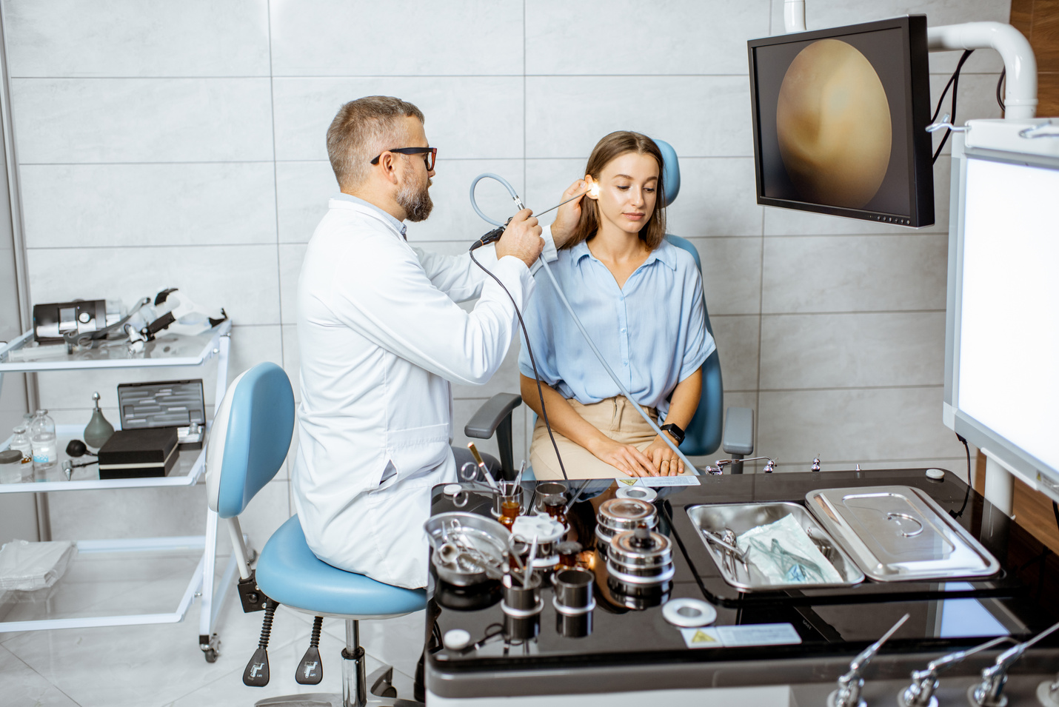
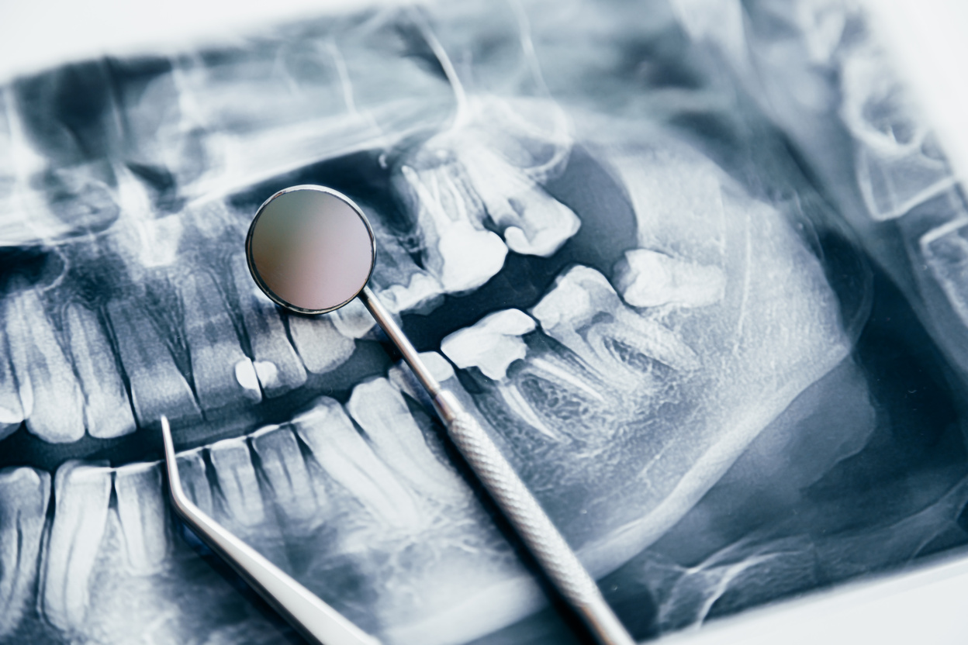
ENT / MAX-FAX
Glan Clwyd
Unbanded
(LIFT)
8AM-4PM WARD 5
What is your responsibility?
As an FY1 you will have a lot of jobs! Your most common responsibilities will be:
Reviewing patients
Rewriting drug charts
Cannulating
Taking bloods
Making referrals
Mental Capacity Assessments
Signing forms to list patients for community
Giving family updates
How does ward round work?
In the notes, you should document:
Date + Time
Reason for admission
Interventions done
NEWS score
What antibiotics + what day they’re on
New reviews since last ward round (e.g. seen by SALT, PLN, etc)
Observations + Examination findings
Plan of the day
Specific things to comment on are:
OMFS = flaps, drains, dopplers, pulses
ENT = swallow, speech, hearing, drains
OMFS is very specialised and is more observational. You will also work with DCTs (Dental Core Trainees).
You will assist in threatre E on mondays (head and neck cancers), then the rest is minor ops (MOPS) and clinics
On ward 5 there is a mix of ENT/OMFS, urology, and general medicine. The day starts at 8am with handover in the doctors office.
There is a handover sheet that is updated during the day (pm sheet) and the night (am sheet).
Your role is to identify why each patient is here (often post-op), what’s been done (find the post-op notes in their folder), and any follow-up that needs doing such as bloods, drain removal, suture removal, appointments, and antibiotics + duration. Most of the time, the post-op plan is very clear in the notes.
Longer stay patients may need scans and discussions with other specialities.
ENT shares on call weekends with Wrexham, so alternate weeks YGC gets all new/emergency cases. You need to know so that important information can be relayed to the relevant team.
Conditions to Know
ENT/Max-Fax has many conditions and can be very complex - don’t stress trying to be an expert! The basics are:
Otitis media /externa - possible osteomyelitis
Tonsillitis and tonsillectomies
Quinsy
Head and Neck Cancer + Anatomy
Laryngectomy vs Tracheostomy
IMPORTANT BLEEPS
ENT On Call - 1400
OMFS On Call - 1401
10

Slide 11
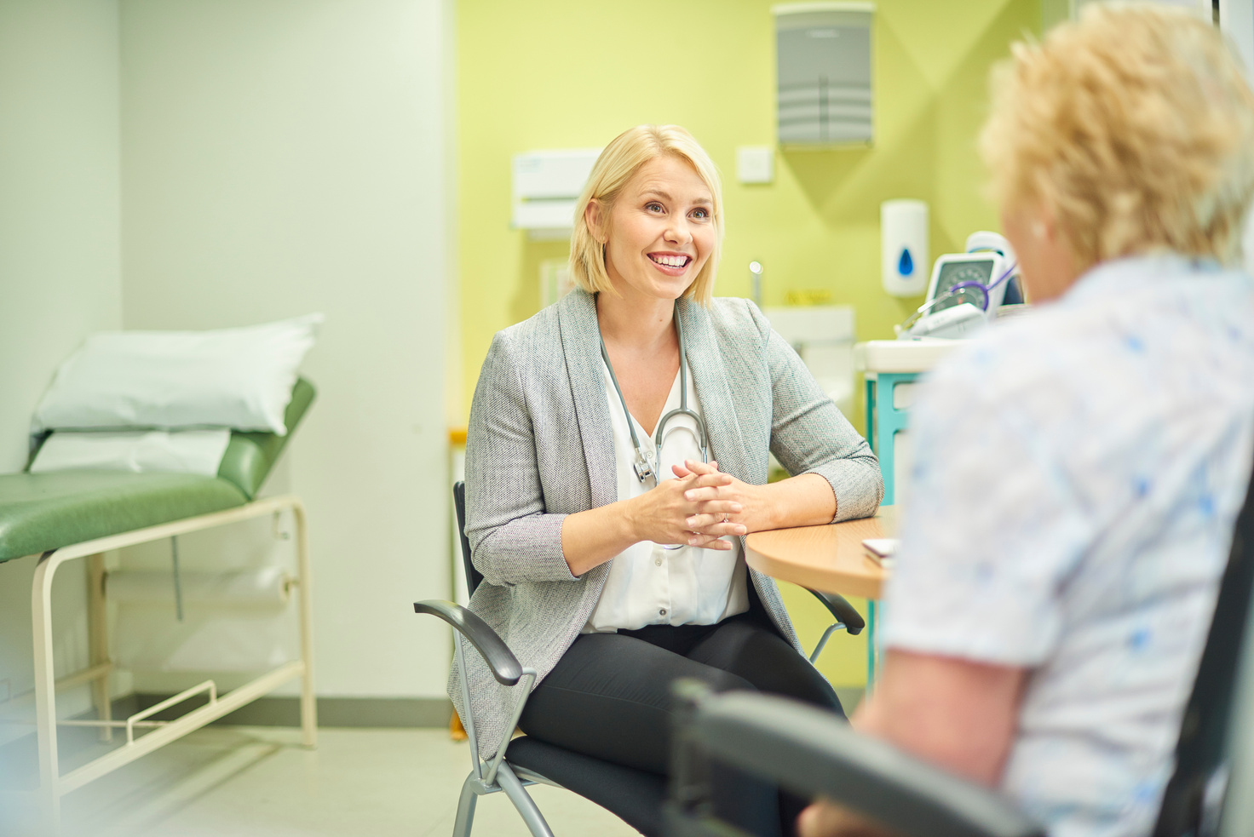

GENERAL PRACTICE
Glan Clwyd
Pay Band 1B
8AM-4PM GP Surgery
What is your responsibility?
Some FY1s will do this rotation as part of their LIFT programme. However, this page is about GP as an FY2. You will be responsible for:
running your own GP clinics
helping out with the duty list
interpreting investigations
making referrals (this can be routine, urgent or even direct referrals to medics/surgeons etc)
home visits
How does it work?
Your typical week will be made up of your own clinic time with a set amount of patients, helping the duty doctor and home visits. Depending on the GP you are at you will start with longer appointment times and work your way down if you feel comfortable (for me I started at 1 hour and am now down to 30 minute appointments). Your clinic time will also include catch up slots (free time in between patients) to catch up if you are running behind.
There is a duty doctor at the GP who handles urgent medical problems that can not wait for a routine appointment alongside urgent admin work. When helping the duty doctor the number of patient's you will see can be varied. Urgent admin can involve things like urgent prescriptions and palliative care requests,
As an FY2 you will be expected to attend home visits. Initially, this should be with a GP so you can observe how these should be carried out. Afterwards, you will have home
visits booked in quite regularly. These are usually booked in as your last patient of the morning.
The home visits are a great opportunity to appreciate how a home environment can affect a patients health and how it can be used when assessing patients (e.g. when doing mental health reviews).
It is worth noting that unlike the hospital, GPs utilise an electronic note system and electronic prescribing. Although, electronic prescribing is present you will still have to sign paper prescriptions regularly as the system is still quite new. GPs have also begun to utilise AI systems in their work for example to help scribe consultations so that you can be fully present for your patient. These can be very beneficial to use.
Conditions to Know
GP is extremely varied and you will see all kinds of patients of all kinds of ages so a broad understanding is good to have. Common presentations are:
LRTI and URTI
Otitis media, eustachian tube dysfunction, and sinusitis
Anxiety and depression
UTI
Menorrhagia and dysmenorrhoea
Back pain and osteoarthritis
IMPORTANT BLEEPS
There are no important bleeps for this rotation.
Instead, it would be best to familiarise yourself with important teams available to your practice.
11

Slide 12
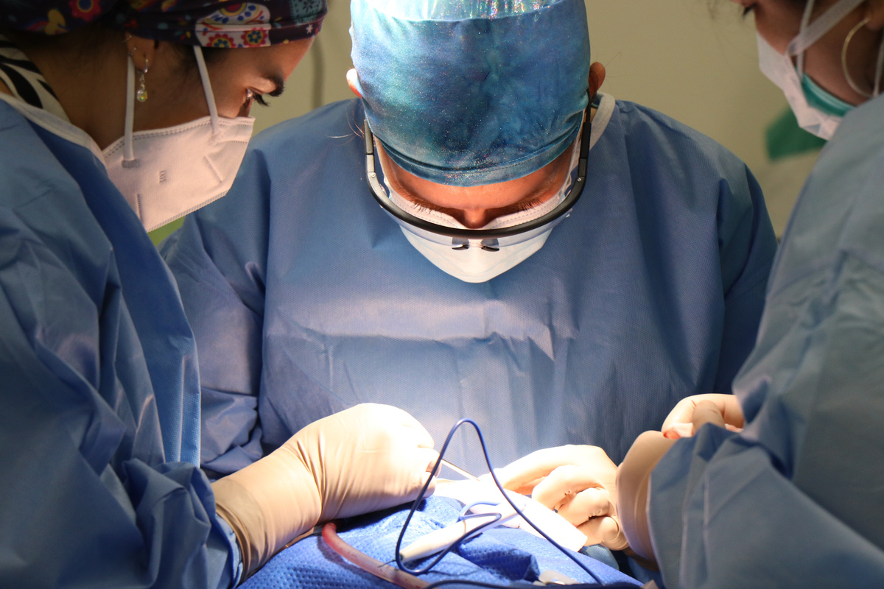
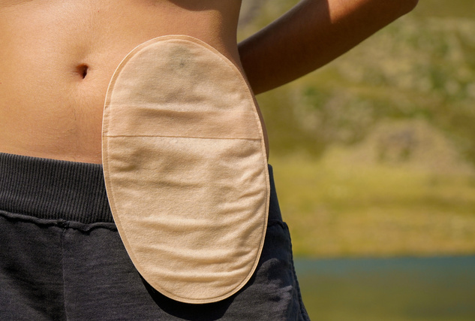
GENERAL SURGERY
Glan Clwyd
Pay Band 1A
8AM-4PM WARD 8
What is your responsibility?
As an FY1 you will have a lot of jobs! Your most common responsibilities will be:
Reviewing patients
Rewriting drug charts
Cannulating and taking bloods
Making referrals
Giving updates to family members
Attending theatre
Writing DALs/TTOs
You will be split into team A or team B. Each team has specific consultants with patients you will review on ward round. You will print out the list for each of your consultants unless they are on post-take that day. The consultants, or their registrar, will review their specific patients and you will join them. There is a ward round proforma in the notes that makes it really simple and straightforward to write out everything for that patient.
The key features to include are all of the observations from the NEWS chart, even if they are normal, and the input/output.
You will often have theatre time on your rota. Go to the changing rooms on the ground floor and go to the theatre for WHO check in. You can find your theatre list in DOSA by the nurses station. You are expected to scrub in!
How does ward round work?
How does Post-Take work?
You will meet in the SDEC area behind the curtain and collect the handover list. You may also need to print out the list for the consultants patient list if the SHO hasn’t already done this. You will then go with the consultant to review every new general surgery patient from A&E as well as their regular ward patients.
As you go, write down jobs for each patient as it will be down to you and the SHO to do these jobs before 4pm.
Is there theatre time?
Conditions to Know
General Surgery has many conditions and can be very complex. The most common topics are:
Cholecystectomy
Cholecystostomy
Biliary Colic
Hemicolectomy
Hartmann’s Procedure
Small/Large Bowel Obstruction
IMPORTANT BLEEPS
Stoma Nurse - 4601, 4705, 3785
Dietician - 4265 / 4267
Anaesthetics - 1500
ITU - 1505
Urology SpR - 5352
Radiology Consultant - 843 888
12

Slide 13
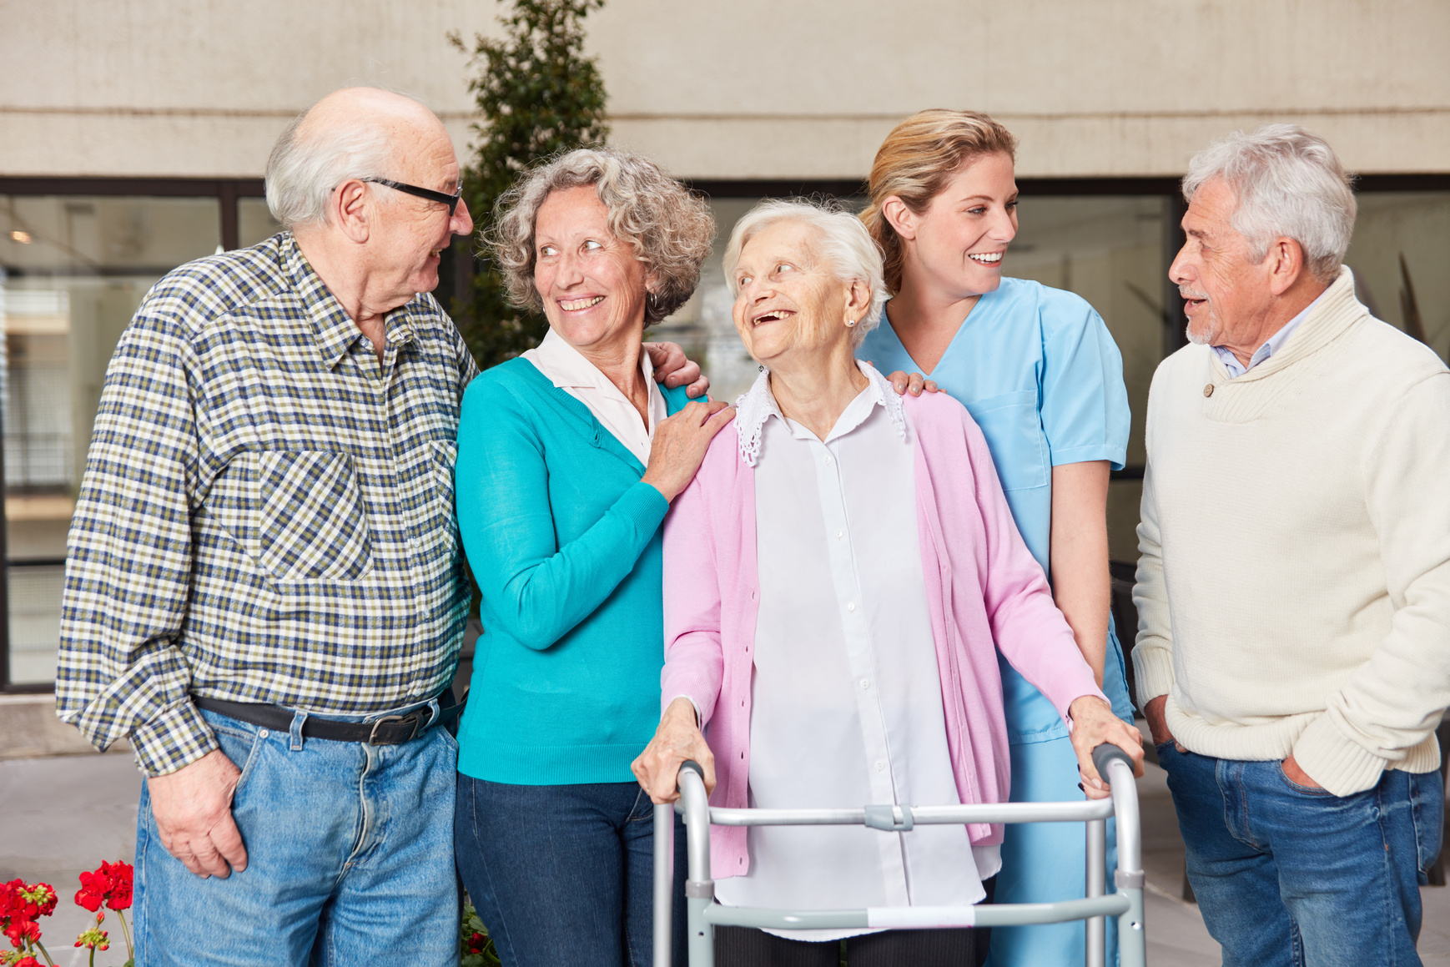
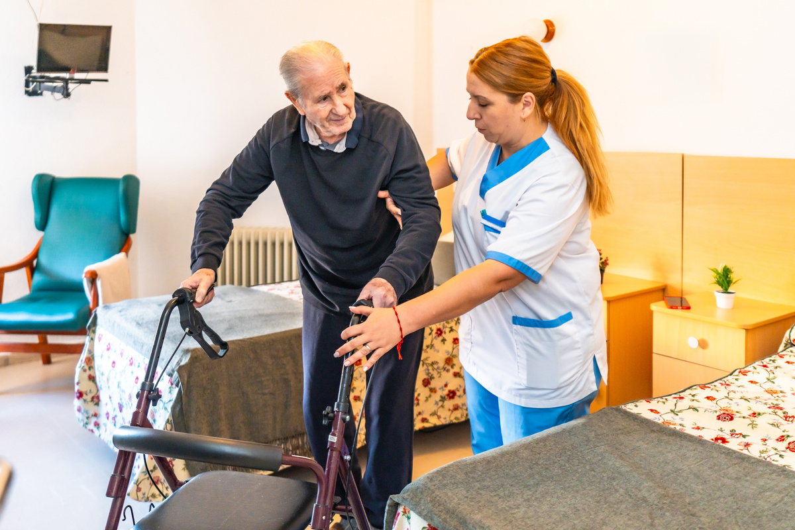
GERIATRICS
Glan Clwyd
Pay Band 1B
9AM-5PM WARD 1 & 2
What is your responsibility?
As an FY1 you will have a lot of jobs! Your most common responsibilities will be:
Reviewing patients
Rewriting drug charts
Cannulating
Taking bloods
Making referrals
Mental Capacity Assessments
Signing forms to list patients for a community hospital
Giving updates to family members
On ward 1, often the 25 patients will be divided between the Doctors working that day. You can have anywhere between 13 and 4 patients.
You will review each of your patients on your own and formulate a management plan. Often there will already be a plan in the notes from the previous day to help guide you. If this patient is new to the ward, you will review this patient with the consultant (or they will review and let you know what jobs need doing).
At 11am, there is a board round where you will present your plans to the ward sister, PT, OT, and other AHPs. This is a great opportunity to clarify anything and learn what other tasks are needed. Often you will be asked if the patient is medically fit for discharge/listing (for nursing homes etc).
How does ward round work?
For ward 2, often ward rounds are more traditional where you will see patients with your specific consultant. You will see patients by consultant rather than by bay. This will often include outliers on other wards.
For both wards, you may be expected to attend discharge hub to write a discharge summary. For this you will need the notes and drug chart. However, make sure you ask which consultant the patient is under before you attend as they may be under the other wards’ consultant.
Visiting is 2-4pm and is when you often are asked to give family updates.
Conditions to Know
Geriatrics has many conditions and can be very complex. The most common presentations are:
Fall +/- long lie
Aspiration Pneumonia / CAP
Confusion / Found Wandering
Delirium
UTI
Heart Failure
Stroke / TIA
IMPORTANT BLEEPS
PLN (Psych Nurse) - switch
Acute Oncology - 9911
Nutrition - 6686
Dietician - 4265 / 4267
SALT - switch
Anaesthetics - 1500
13

Slide 14
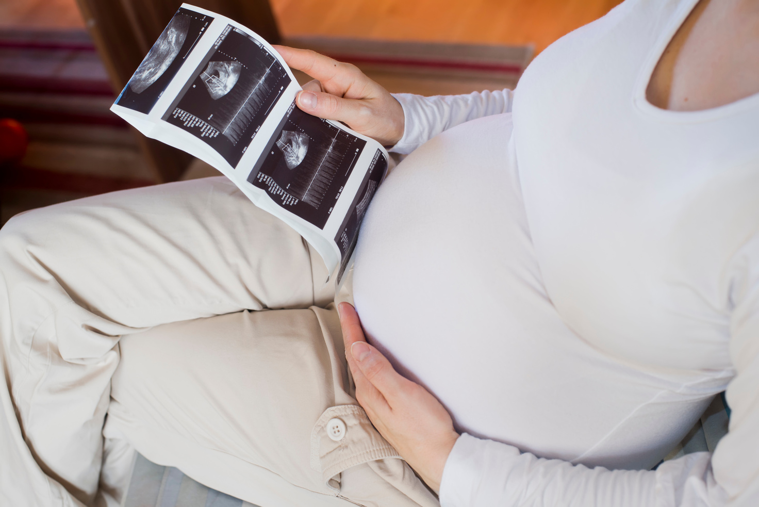
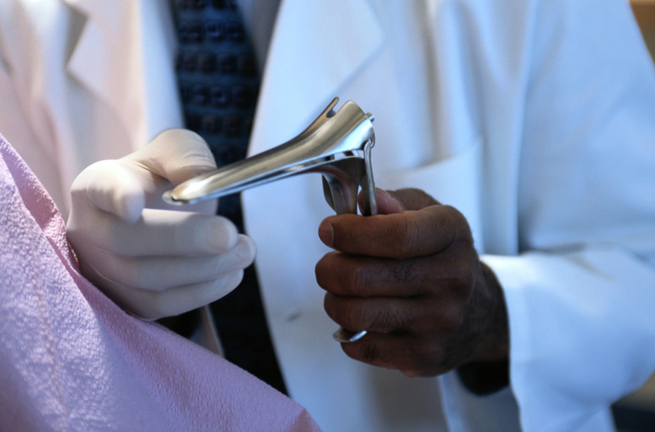
OBS & GYNAE
Glan Clwyd
Pay Band 1A
8:30AM-5PM WARD 22/23/19A
What is your responsibility?
Obstetrics and Gynaecology is a new rotation for 2025 with FY1s being placed here for the first time this year.
As an FY1 you are supernumerary. You will attend ward rounds with seniors and be responsible for basic FY1 jobs (DALs/TTOs, cannulas, bloods).
There will be opportunitis to clerk patients independently in EGU,/MOAU however you are expected to perform examinations (speculums) under supervision and discuss all Mx plans with seniors.
You will also be able to attend clinics, gynae theatres and assist in c-sections.
Currently, there are no scheduled on calls for this post.
You will attend 2 handovers: 8:30am, and 1pm, in the delivery ward.
To begin with, you are likely to stick to gynae and be introduced into obs after the first 2 months.
You will get a good mixture of wards, theatre, and clinic; there is lots of learning and great opportunities to get involved in lots of different aspects of care.
One skill you absolutely need to get comfortable with is a speculum examination. This will be the most common skill you use - so get used to the technique, anatomy, and indications.
As mentioned, there are low expectations as this is a specialised field - it is really easy to escalate to your seniors.
Rotas are unfortunately often updated which can be frustrating, so make sure to keep an eye out for any changes here,
What will my day look like?
Conditions to Know
O&G has many conditions and can be very complex. The most valuable things to know are:
Miscarriages
Ectopic pregnancies
C-sections: anatomy, indications
Pre-eclampsia
Delivery methods: vacuums, forceps, etc
HVS
PID / Sexual heatlh
Gynaecological cancers
Post-surgical complications
IMPORTANT BLEEPS
Out of hours SHO - 4693
Paeds SHO - 1300
14

Slide 15
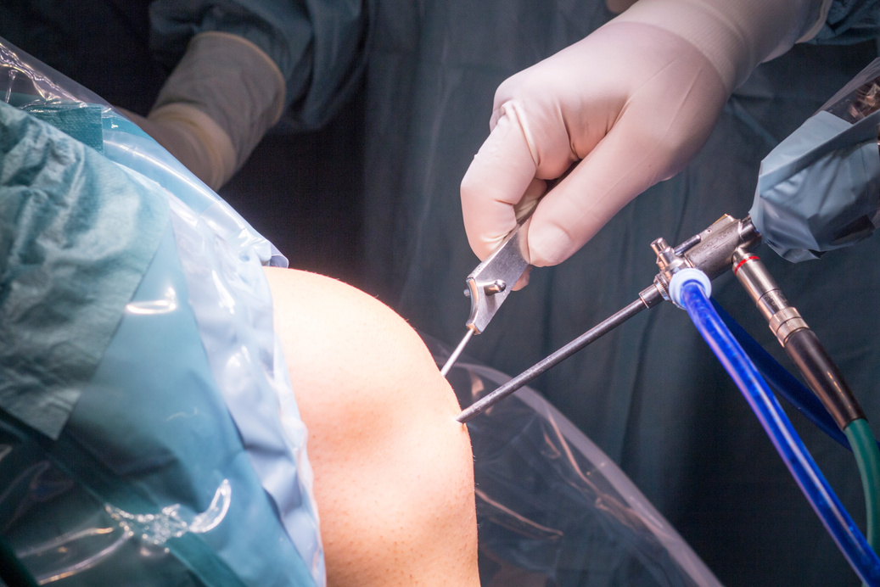
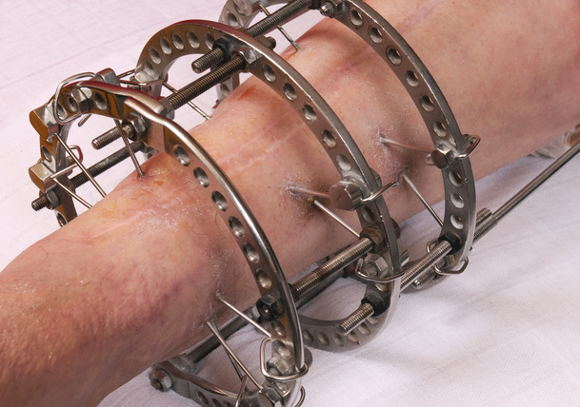
ORTHOPAEDICS
Glan Clwyd
Pay Band 1B
8AM-5PM WARD 7
How does the ward work?
FY2
ONLY
At 8am, you will attend handover in the teaching room between ward 7/8. The night SHO will present any overnight cases that may be for theatre or just need discussion.
A “NWD” will be on ward 7 with the other SHOs. Ideally, there should be 3 SHOs on the ward and each will take a specific area (Bay 9 + 10, Bay 7+ 8, or Cubicles).
You will then do your own ward round, unless a senior is available to review their patients in your area. They may come later in the day and will re-review the patients with you.
At 10:30am, you will then attend board round to let the nurses, PT/OT, and progress chasers know your plans.
There is an orthogeriatrician team on the ward who will independently review the NOF patients but you should still review these patients when you can.
How do I do On Calls?
On call works just like any other specialty! You will take referrals, so make sure you read IPS to make sure you know who to accept under orthopaedics.
Essentially, your options are to reject the referral, accept and admit the patient, or to see in fracture clinic.
Patients to be admitted should be clerked in the blue proforma, unless they are a NOF patient. There is a separate NOF proforma in the utility room in minors inside the yellow folders. Make sure to prescribe DVT prophylaxis, fluids, analgesia, and laxatives as a baseline!
Any admissions/referrals need to be added to the BCU list.
What are trauma weeks?
You will attend the 8am handover before leaving with the on call consultant to see the patients on the trauma theatre list that day.
You will be expected to scrub in for these and make sure that TTOs are done if any of those patients are day cases.
Expect to get involved! It is the best learning opportunity so don’t be afraid to ask questions... but make sure you’re ready to be quizzed too!
Conditions to Know
IMPORTANT BLEEPS
You will need to have a good understanding of anatomy for this, as well as the below key conditions:
NOF # + Management Options
Ankle # + Weber Classification
Supracondylar Fractures
Olecranon Fractures
Compartment Syndrome
Cauda Equina Syndrome
Necrotising Fasciitis
SHO On Call - 1504
SpR On Call - 1509
Outliers SHO - 4492
Trauma Secretary - 844 092
Trauma Coordinator - 3005
Theatre G - 845619
EQ Radiology - 843 967
15

Slide 16
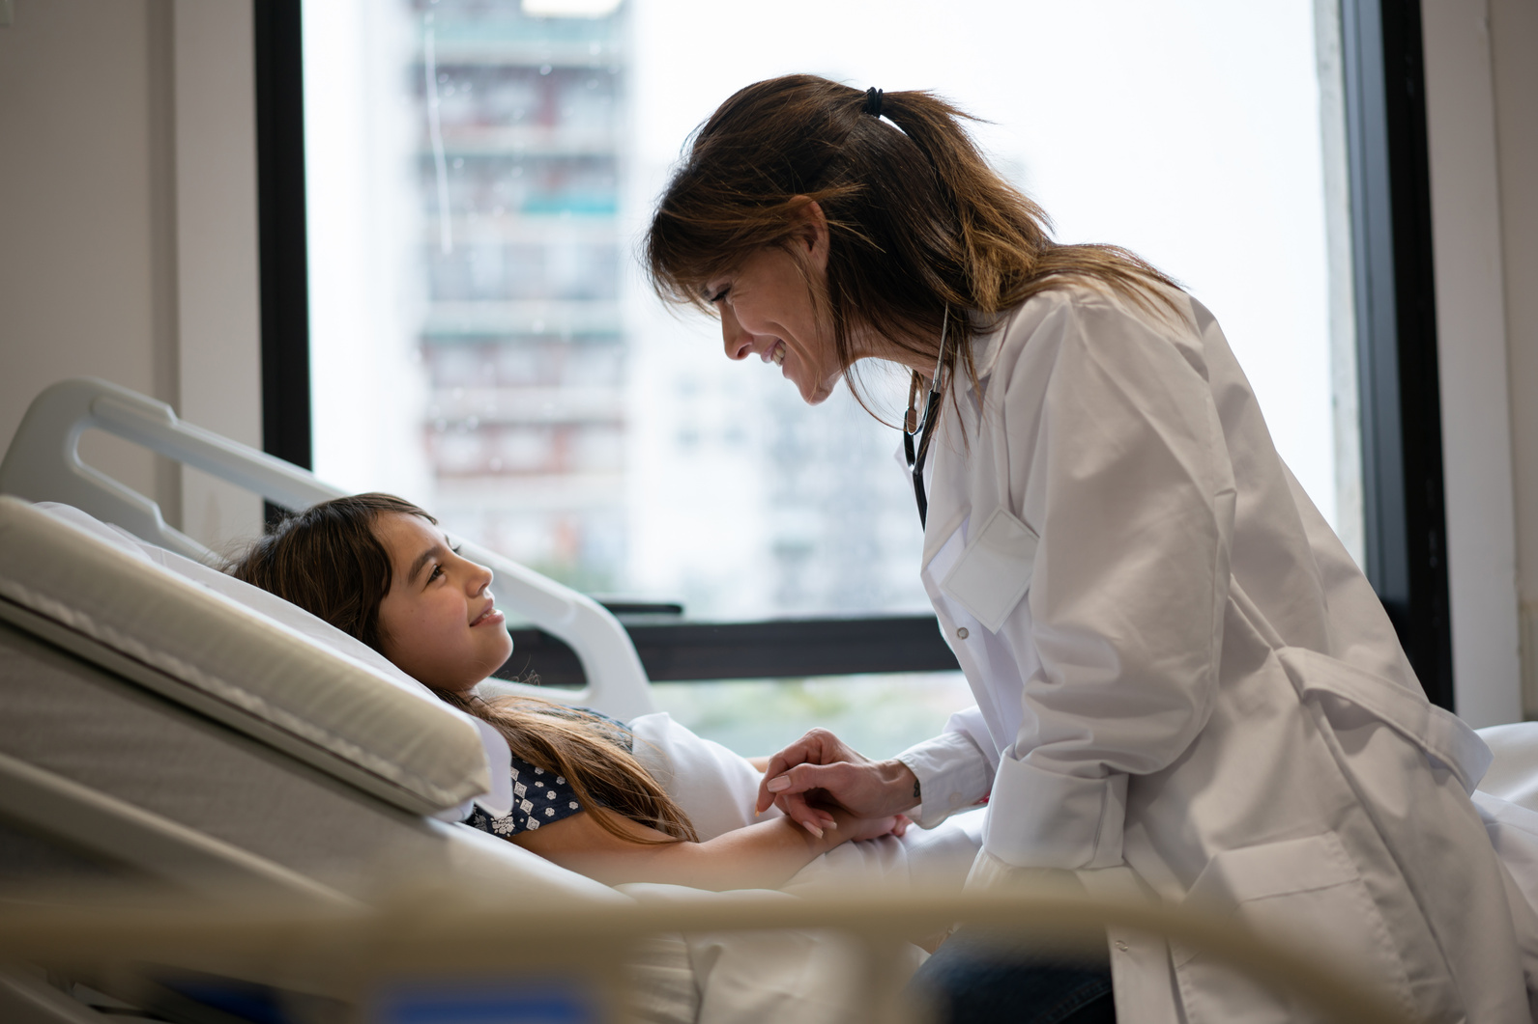
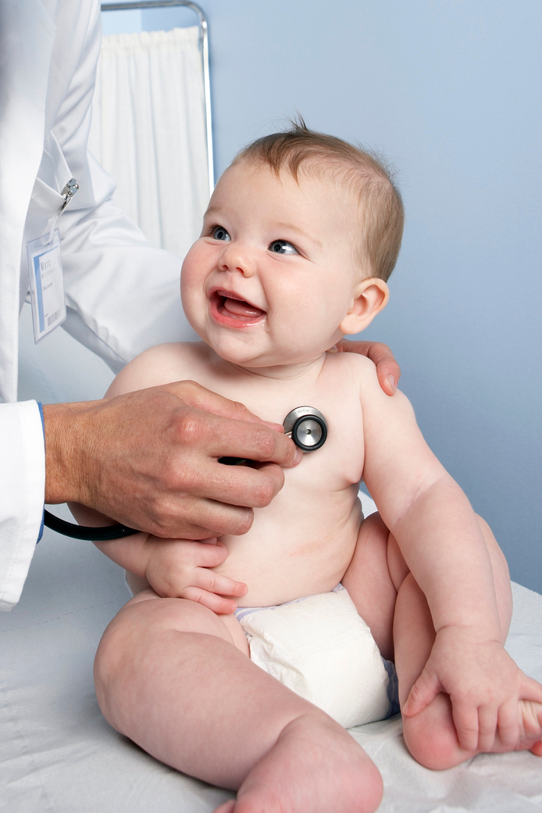
PAEDIATRICS
Glan Clwyd
Pay Band 1B
9AM-5PM Ward 17 & 18
What is your responsibility?
As an FY1 you are supernumerary in Paediatrics. However this does not mean you can’t get involved You will have plenty of learning opportunities and a chance to practise new skills. Some jobs you can get involved with are:
Clerking patients coming through PAU
Rewriting drug charts
Cannulating
Taking bloods
Making referrals
Writing DALs
How does ward round work?
Ward rounds usually start around 9.30am after handover and departmental teaching that takes place every day apart from Thursdays. Before ward round begins a huddle in the doctors office takes place where a senior nurse highlights any issues or DATIX’s from the week. After this the junior staff is allocated different jobs for the morning uch as completing DALs leftover from the night or going on the ward round.
Ward rounds are led by the consultants and registrars. While you are not expected to round patients by yourself as an FY1 but you might get the opportunity to review patients on ward rounds under supervision.
As an FY1 you will have 1 on-call day a week either a Tuesday or a Thursday. You will be working from 8.30 until 20.30 on these days and are expected to join the consultant ward round in the morning.
The paediatric ward is divided into two sides; inpatients and PAU. PAU or paediatric assessment unit is where new patients referred through A&E and GP will come up to be clerked by the juniors. As an FY1 you will get the opportunity to clerk patients coming through and formulate your management plans before they get reviewed by a registrar or a consultant. If you are willing you will also have the opportunity to hold the referrals bleep.
You will also get 1 week a month in neonates where you get to do newborn examinations, join ward rounds and learn more about conditions of the newborns.
Conditions to Know
Paediatrics is a specialty where you get to see a vast array of conditions. Some common presentations include:
Bronchiolitis
Asthma
Viral Induced Wheeze
Eczema
DKA
Febrile Convulsions
Meningitis
Appendicitis
IMPORTANT BLEEPS
Paediatric Registrar - 4647
General Surgery Registrar - 1508
ENT SHO - 1400
Alder Hey - 0151 228 4811
16

Slide 17
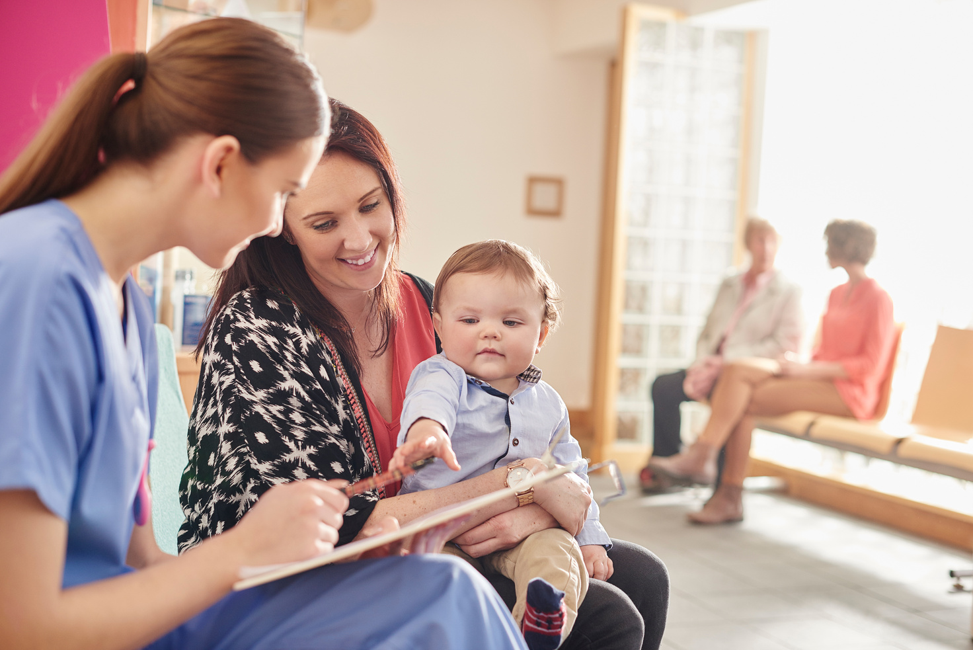

COMMUNITY PAEDS
Glan Clwyd
Pay Band 1B
9AM-5PM Multiple Sites
What is your responsibility?
FY2
ONLY
As an FY2 in Community Paediatrics, your time is spent between running your own clinics across various sites in the area and admin time.
You will have plenty of opportunities to observe and attend a variety of community paediatric clinics. These clinics range from generalised areas such as general paediatrics to specialised areas such as neurological developmental clinics.
You will also have opportunities to attend safeguarding meetings which are really good learning opportunities.
There are also weekly and monthly meetings to discuss cases and for teaching. This is a good time to get your CBDs!
How does a typical day work?
You will have roughly 3 of your own clinics per week and for the days you don’t have clinic, you will be either observing in another clinic or have Admin time.
There is a variety of different clinics for you to sit in, so make sure to take advantage of the learning opportunities and be open to experience the more challenging areas of community paeds.
A typical morning in Community Paediatrics will be running your own clinic within the Community Paediatric Continence Team.
You will then spend the afternoon writing / dictating letters, sending any referrals, and ensuring follow-up plans are completed.
There is a lunchtime meeting once a week on Teams which is important to join and can be a good opportunity to discuss any cases with seniors.
Conditions to Know
Nocturnal Enuresis
Paediatric Constipation
Neurodevelopmental Conditions
To be aware of:
Paediatric Safeguarding
IMPORTANT BLEEPS
There are no important bleeps in community paeds.
However, try and familiarise yourself with any important contacts and services to signpost people to.
17

Slide 18

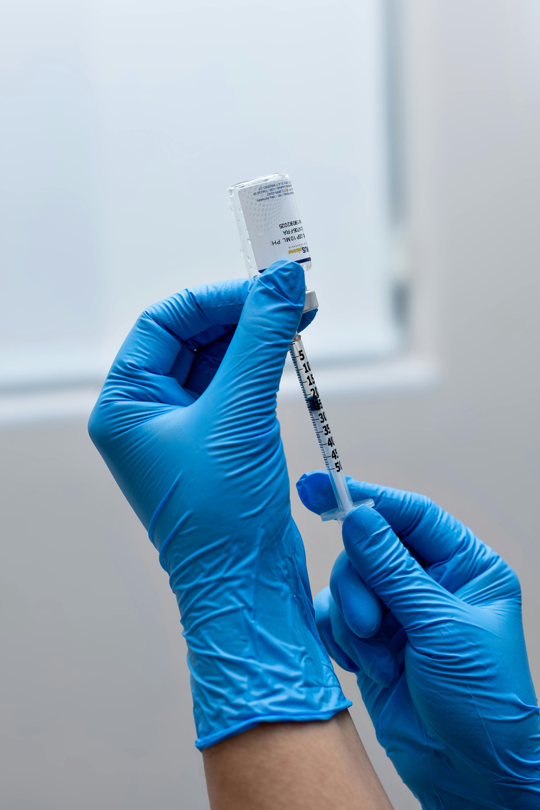
PSYCHIATRY
Glan Clwyd
Pay Band 1B
9AM-5PM Ablett
What is your responsibility?
FY2
ONLY
You will split your 4 months between community at Hafod CMHT and in-patients.
In CMHT you are shadowing the consultant/reg. Occasionally you will do bloods or an ECG, or independently see patients.
In the Ablett you are attending ward rounds and handling any physical health concerns of patients. This can involve physical reviews, blood / ECGs, referrals , and discharge letters.
How does ward round work?
On-Call
Ward rounds are done once a week, usually on a Wednesday and Thursday by an approved clinician.
Usually, it is divided into an AM & PM session, depending on how many patients are on the male or female ward the AC has.
Sessions usually last about 30 minutes.
Documenting on MH ward rounds are lengthy and require you to include a MSE. This is a good time to check the patients drug chart to see if it needs rewriting.
Mostly involves clerking new admissions, which includes: history taking, physical health assessment, ECG, bloods, and writing up the prescription chart.
You are also responsible for any acute medical problems from the wards.
Most commonly these would be for reviews post restraint or post fall.
You also cover the satellite units of Bryn Hesketh and Tan-Y-Castell after 5pm and on weekends.
Conditions to Know
Schizophrenia
Bipolar Affective Disorder
Depression
Generalized Anxiety Disorder
PTSD
Obsessive-Compulsive Disorder
Dementia
ADHD
IMPORTANT BLEEPS
Duty Doctor - 6600
Duty Nurse - 6601
18

Slide 19
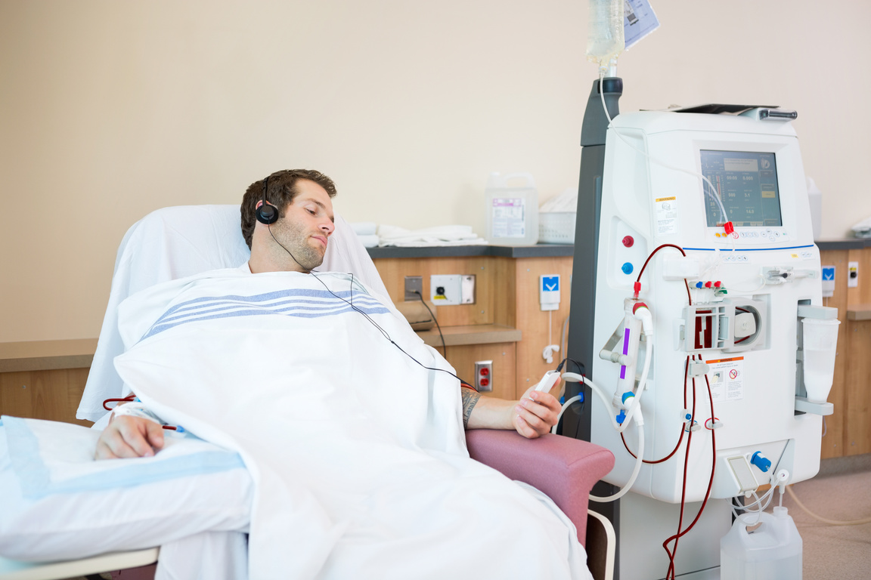
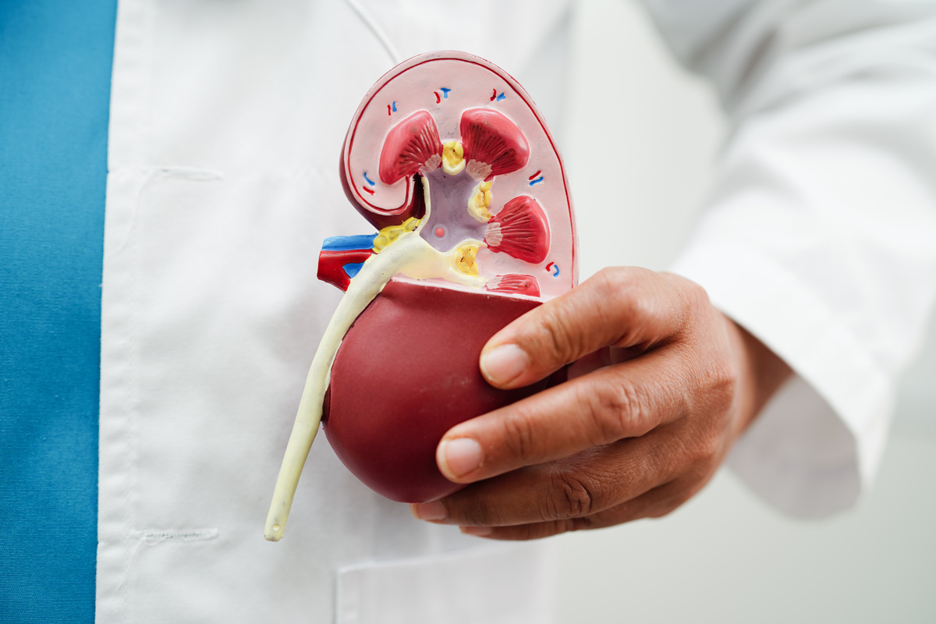
RENAL
Glan Clwyd
Pay Band 1B
9AM-5PM WARD 12
What is your responsibility?
As an FY1 you will have a lot of jobs! Your most common responsibilities on renal will be:
Reviewing patients (with or without the Consultant)
Cannulas
Occasionally bloods (phlebotomists and renal nurses are pretty good with covering this though!)
DALs/TTOs
Seeing outliers
How does ward round work?
Board round starts at 9am (exactly!) with the nurses, OT, PT, and doctors. Here you will go through the 3 consultants patients with a recap and plans for the day.
After this, you will pick a consultant to work under - often if you have seen a consultants patients the day before, you will probably stay on their service. It is valuable to switch between the 3 every so often as each one has their own style and will teach you in different ways.
If the consultant is in you will see their patients with them. If they are not in (e.g. in clinic or on call), you will see their patients on your own. If you have any issues, they are easily contactable and the other doctors will be able to help if not.
Often, if the consultant was in clinic that morning, they will call you in the afternoon to do a run-through of everything and to check everything is okay.
For those who are keen, registrars will do line insertions (for HD) and renal biopsies - often they are more than happy to accommodate you in observing these procedures!
Overall, renal is a really well-supported rotation to have. It can be difficult at times as these are typically very unwell patients, so always speak to your seniors if you are struggling. The consultants are really keen to support and make sure you are okay.
You will learn a lot on this rotation - it is fast-paced and a lot of acute medicine!
Conditions to Know
Renal has many conditions and can be very complex. The most common things to know:
Acute Kidney Injury
Chronic Kidney Disease
Types of Dialysis (HD/PD)
Indications for dialysis
IV fluid types and indications for each
Albumin uses
Diuretic uses
Parathyroid Hormone
IMPORTANT BLEEPS
Renal Unit - 844 094
Micro - “for advice” via switch
CKD Nurse - 845 672
Urology SpR - 5352
Vascular Lines - 845 644
19

Slide 20
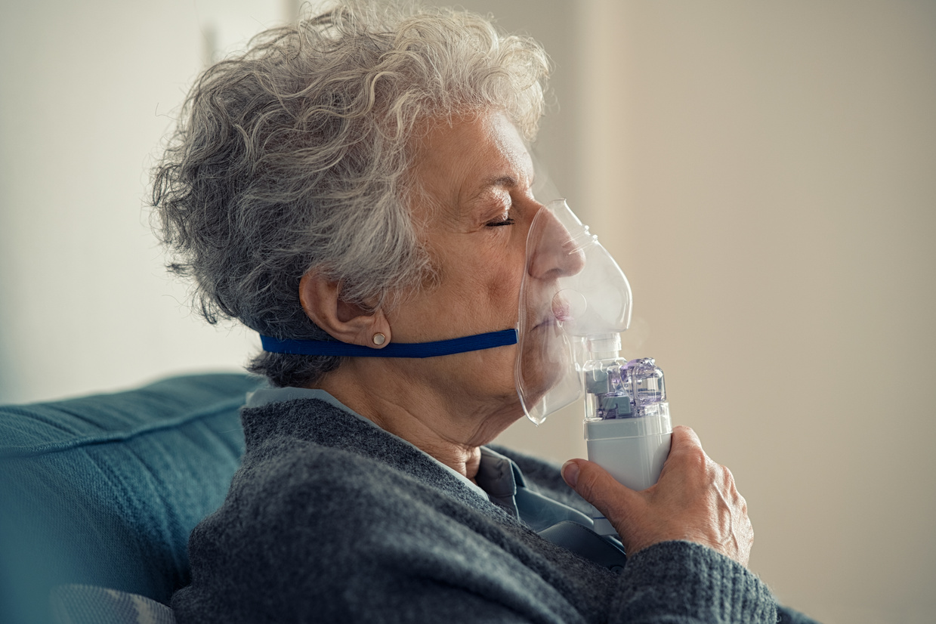
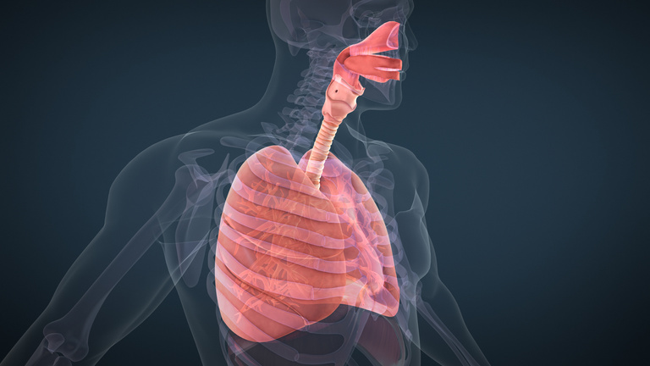
RESPIRATORY
Glan Clwyd
Pay Band 1B
8.45AM-4.45PM WARD 6
What is your responsibility?
Each day starts with a board round at 8:45 AM, attended by consultants, all resident doctors, nurses, OT, and PT.
The team reviews each patient, discusses overnight changes, identifies urgent reviews, and plans discharges. There are six respiratory consultants, with two on at a time managing all inpatients (including outliers), splitting the list 50/50.
They do ward rounds twice a week (typically Monday and Thursday), with outlier reviews on other days.
When the consultant is not doing their ward rounds, a registrar (if available) will do the round. On two days a week, you’ll lead the ward round yourself.
After board round, the team splits into two:
One covers Ward 6
One covers outliers (divided by location or consultant)
Registrars are always available for support. One registrar a week is in pleural clinic, seeing patients or doing bronchoscopies amongst other procedures.
Ward round reviews typically include:
Checking the medical plan and overnight changes
Recording the NEWS2 score
Reviewing medications
Planning discharge or further management
Some respiratory patients are on NIV or have chest drains. You’ll review both:
NIV nurses assist with machine adjustments
For chest drains, assess function, flushing needs, or removal
You’ll also have opportunities to perform supervised respiratory procedures to build your skills.
How does ward round work?
Ward rounds begin after the 8:45 AM board round, with the most urgent patients seen first. If someone is acutely unwell, a registrar will usually lead that review.
Conditions to Know
Respiratory has many conditions and can be very complex. The most common respiratory presentations are:
Respiratory Failure
Pneumonia
IECOPD
COPD
Asthma
Cancers - primary and secondary
IMPORTANT BLEEPS
Respiratory Nurse - 4606
ECG - 4423
20

Slide 21
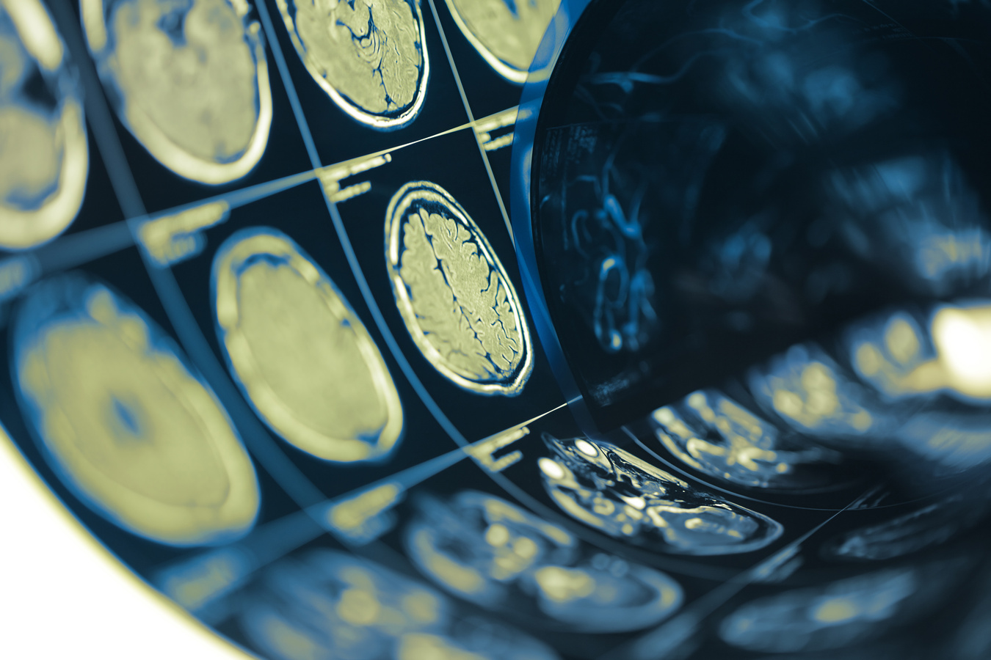
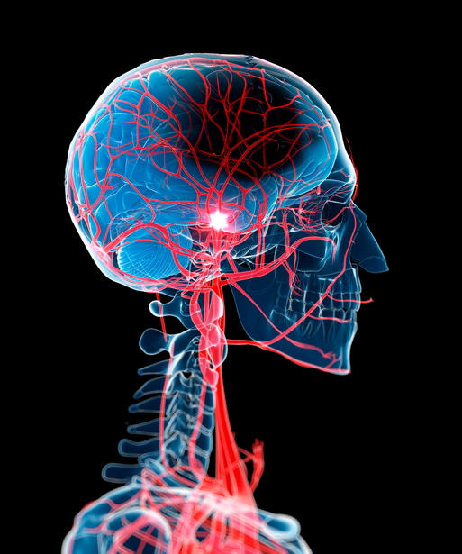
STROKE
Glan Clwyd
Pay Band 1B
9AM-5PM WARD 11
What is your responsibility?
FY2
ONLY
Stroke is an intense but interesting placement where you will learn a lot of valuable medicine.
There are four consultants on the stroke ward. Three of these are COTE (Care of the Elderly) consultants and one is a stroke consultant.
Typically, patients presenting with stroke will go under the stroke consultant, whereas the general medical patients will be shared between the 3 COTE consultants.
Your responsibilities as an FY2 doctor include:
Going on ward rounds
Doing your own ward rounds
Reviewing outliers
Reviewing acutely unwell patients
Completing referrals to other specialities
Ordering and vetting scans
Writing discharge letters
Clinical skills: bloods and cannulas
This is similar to any general medical job. Having a broad understanding of medicine is vital but reading up on specific pathways and pathologies is essential as stroke can be very specialised.
The consultants are very supportive and you should use this rotation to its full potential.
How does ward round work?
Ward round starts at 9am each morning.
When the consultant is in, you will go to ward rounds with the consultant. If the consultant isn’t in that day you will do your own ward round.
Generally, you will stay with the same consultant the entire week as this ensures continuity of care.
At 11am board round takes place, this is when the entire MDT meet to discuss each patient and their plans going forwards.
Conditions to Know
Ischemic stroke and TIA
Hemorrhagic stroke
Cerebral amyloidosis
Stroke mimics
It is worth learning the acute and long-term management of ischemic and hemorrhagic stroke and TIA
IMPORTANT BLEEPS
Stroke Nurse - 3643
EQ Radiology - 843 967
21

Slide 22
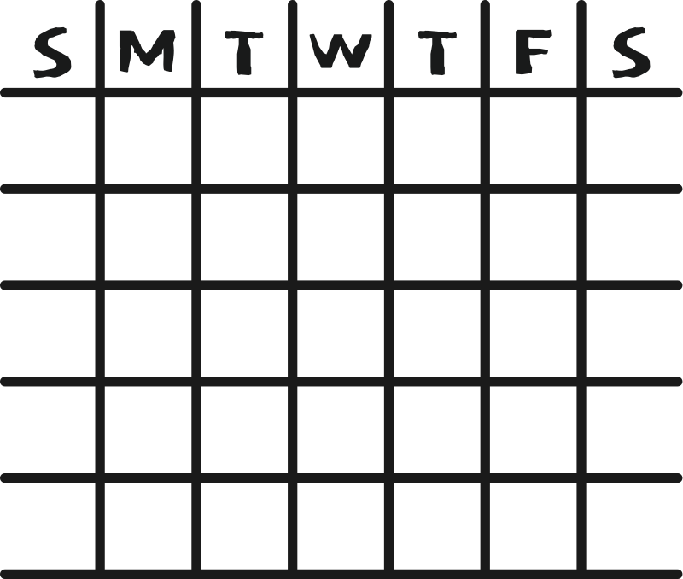
MEDICAL ON CALL
Glan Clwyd
9AM-9:30PM CLERKING/WARDS
When Will I Be On Call?
ON
CALL
You will have a medical on call once weekly -
it will follow the pattern shown.
ON
CALL
Weekday On Call
ON
CALL
You will meet in the AMU meeting room for handover. Collect the list from the SHO, collect the 1501 bleep, and meet the consultant on call for Post Take.
As you review patients, note down any jobs next to the patients name and update EAS that the post-take has been done. and what speciality they should be allocated to.
When you have finished post-take, you will get started on the jobs on your list.
The jobs list generally consists of echo requests, referrals, booking scans, ordering bloods, and TTOs.
When you have finished, you can either take one of your 30 minute breaks (you get two!) or start clerking.
In some cases, you might not have any time for clerking as the consultant on call may want the FY1 to attend more post-takes (this leaves the SHOs to clerk instead as they are generally faster).
However, when possible try to clerk some patients from EAS - it’s really helpful but also good practice.
Make sure you finish for handover at 9pm. Do your best to not handover any post-take jobs when possible as there are less staff overnight!
ON
CALL
ON
CALL
ON
CALL
REST
REST
ON
CALL
ON
CALL
Weekend On Call
A weekend on call will have two FY1s available - normally you will be split up.
One FY1 will take the wards on Saturday and clerk on Sunday, the other FY1 will clerk on Saturday and cover wards on Sunday.
During the 9am handover, you will decide between you who will take what.
For clerking, the process is the exact same as a weekday on call; post-take and clerking.
For wards, you will sit down with the ward SHO and access the EAS handover list. Print out the list (it will often need editing first!) and discuss how you want to tackle the wards. The two most common ways are going to every ward together, or for the FY1 to take floor 2 and Enfys, and the SHO to take floor 3 and 4.
You will mostly be bleeped for bloods, rewriting drug charts, and to review a high NEWS. A lot of wards will also have a jobs list that the nurses have made for you.
Weekday On Call
Clerking FY1 - 1501
Ward FY1 - 4598
Clerking SHO - 1602
Referrals SHO - 1502
Registrar - 1503
22

Slide 23
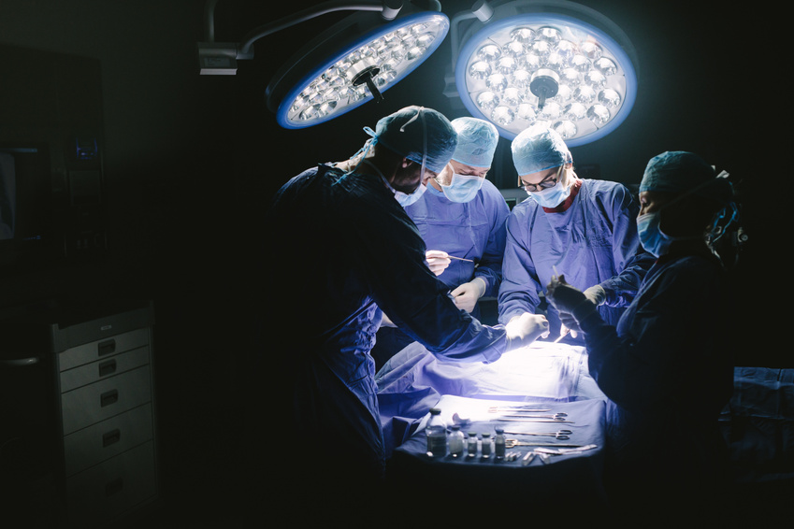
SURGICAL ON CALL
Glan Clwyd
8AM-9PM / 12PM-12AM WARDS
Weekday On Call
ON
CALL
ON
CALL
ON
CALL
ON
CALL
REST
Surgical shift patterns are 12pm-12am Monday to Thursday.
On a Friday, the shift is 12pm-9pm as you will also be working the weekend.
Your role will be focused on ward care; you cover the surgical wards (ward 8, ward 5, ward 3, ward 19A. SAU, and EDOU) and any surgical outliers.
You often receive a verbal handover for any bloods or outstanding jobs at 5pm. The FY1s finish at 4pm and should handover to their SHO. If the SHO still hasn’t done the job, this becomes your responsibility if appropriate.
At 8:30pm there is a handover in SDEC for the SHO and registrar. This is a really good opportunity to ask any questions about issues you have on the ward if you struggle to get a response through bleeps. The reg will often go to theatre and the SHO will clerk in A&E, so make sure to use this opportunity if you need it! Even if you don’t have anything to ask, it is still important to attend if possible as they will often want a brief update on the wards and to make sure you are okay.
ON
CALL
ON
CALL
ON
CALL
REST
REST
Weekend On Call
A weekend on call will be 8am-9pm and ward based. You will attend handover at 8am in SDEC then go with the registrar or consultant to do a ward round - sometimes you will see all patients, and sometimes you will see select patients.
Often there are lots of bloods to do - it is really important to determine if these are urgent or not as they will really slow you down.
One tip is to look at the last blood results and if there are any abnormalities that need rechecking today, or if this blood can wait for the next day. Generally, INR or vancomycin levels cannot be delayed.
What is my job?
Very often you will be bleeped for patients that are not your responsibility just because you are the surgical FY1. For example, orthopaedics, ENT, and all medical patients are not your responsibility
You will also receive a bleep for all MET calls and cardiac arrests, however, if this is not on one of the wards you cover then you likely do not need to attend as the medics will cover this.
You will cover urology too but for any complex issues bleep the urology SHO.
23

Slide 24
MUST KNOWS
Glan Clwyd
Tips & Tricks from previous FY1s
Microbiology Discussions
You will need to discuss cases with microbiology often when there are infections that are not improving to standard antibiotics, or if the patient has allergies the antibiotics identified as sensitive on cultures.
Speaking to microbiology for the first few times feels scary but they are all generally very nice!
The main tip: come prepared!
Make sure you have the drug chart, NEWS chart, and know their recent blood results (have it open on WCP in front of you!).
To get through, call switch (100) and ask for “Microbiology for advice”. You will be put through to the secretary who will ask for the patients name and G number and your bleep. If the consultant is free immediately, they will put you straight through but often you will be added to a list and the consultant will bleep you when they are free.
Document the discussion and make sure you make a note of the antibiotic, dose, frequency, and duration!
Speaking to Radiology
Potentially a more nerve-wracking phone call than microbiology... but if you are prepared then you should be okay!
Often you will need to speak to radiology to vet a CT or MRI.
In some cases, if the online request is detailed and clean-cut, you won’t need to speak to them. However, to make sure your scan is definitely going ahead or not, you should call them.
To do this, call RED radiology on 843 888. You will be put through to the secretary who will ask for the patients name, G number, your bleep, and reason for call (e.g. to discuss an MRI).
The key for radiology discussions is to make sure you are ordering an appropriate test. If are requesting a CT., you may be challenged on why you are not ordering an ultrasound or x-ray instead!
A tip is to google “CT Abdomen Pelvis indications” (for example) and see what is suggested. Radiopaedia is a great resource for this as it gives a good list of symptoms that you can use in your WCP request.
The aim is to use as much information in your request as you can- try to anticipate what the radiologist wants to know.
For example, which CT request is less likely to need discussion:
“Fever of 38.9C, no response to IV tazocin, CRP 340, MSU negative. Sepsis of unknown origin ?source”
“Sepsis, on antibiotics but no response, ?abdominal source”
Now whilst both have the potential to be accepted, option 1 is more likely to be approved as there are key pieces of information included straight away. Radiologists really do vet these all and have a huge list of scans to report which takes a very long time- they are not going to accept something and add to their workload, as well as give radiation to a patient, when they may not need to.
24

Slide 25
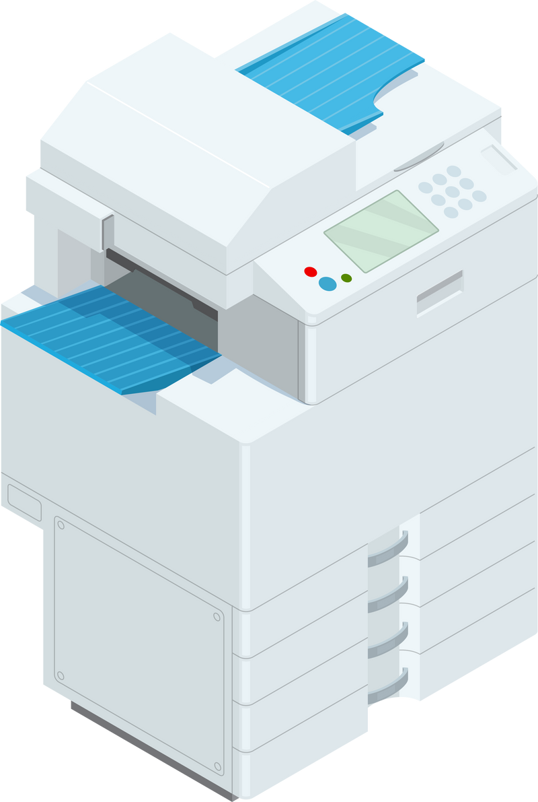
MUST KNOWS
Glan Clwyd
Tips & Tricks from previous FY1s
Referrals
Referrals are straight forward. Most specialties use paper referrals (except orthopaedics and general surgery).
This is basically a written SBAR. Get your key facts across: age, presenting complaint, what is the diagnosis, what's been done so far, and what do you want from that speciality.
For example, if you are referring to dermatology, they are going to want to know where the rash/lesion is, what it looks like, triggering/relieving factors,.
If you are referring for something urgent, make sure you call rather than write a paper referral!
Similarly to the micro/radiology discussion, make sure you are prepared with all clinical information if you are going to refer by phone call! Otherwise, you will waste their time whilst you run off to get their charts or check WCP!
Requesting Echocardiograms
Arguably one of the most common scans you will request is an echo (if you are on medicine)! However, this is done via a paper request, not on WCP.
These can take a few days to actually get done once you’ve sent them off, so it is important that you indicate if they are urgent or not.
On the back of the form there are the indications (if not printed wrong - if this is the case, just type in “echo” into betsi net and it will show you the full form and you can read the indications there).
Essentially, give a brief history of why the patient needs an echo. If for an arrythmia, make sure you have a recent ECG. If for heart failure, make sure you have a recent BNP.
Sending Paperwork
Most wards will have a clerk who will send things for you - however, when you are on call or if you can’t find a clerk, you will need to know how to send them yourself.
Find a big printer (often in the staff room in the corridor between wards) and place the referral/request face up on the top bit with the long edge pushed into the machine gently.
This will wake the screen and you will see “Scan” appear.
Once you clikc “Scan” you will be given an alphabetised
menu of emails to send to.
For echos, if there is no “Echo” button, check under “C”
for “cardiac physiology” as this is the same thing.
Once you have selected the correct location,
click send in the bottom corner!
Put the referral/request in the notes with “SENT”
written on the top so everyone knows!
25

Slide 26
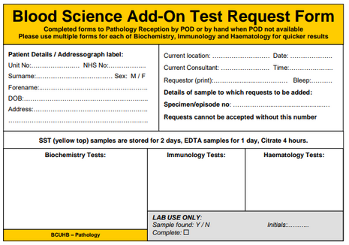
MUST KNOWS
Glan Clwyd
Tips & Tricks from previous FY1s
Add On Bloods
There are specific forms you can send via the pod system if you need to add on a blood. Usually, old samples are kept for maximum 3 days.
Find the laboratory number at the top of
the blood report of the latest blood test
(usually 12 numbers, something like
704876528912)
2. Use an add-on form to write out patient
details, requestor, lab number, and what
test you want adding on
3. Send via a pod to the lab
Endoscopy / ERCP / MRCP
Some scans can be done via WCP request but some cannot. Colonoscopies, Sigmoidoscopies, OGD, ERCP, and MRCP are done via a paper form, identified by an orange border.
If you are requesting a colonoscopy, it will be on the same form as a sigmoidoscopy, so make sure you circle which one you want at the top of the form.
These forms are really straight forward to fill out: you will need their bloods, drugs, allergies, and PMH.
Once completed, you will need to drop them off at the front desk in the gastro day unit which is on floor 1. When you come out of the lifts, go right towards the offices and DOSA. However, instead of going right again to DOSA, turn left, past urology day unit, and follow the corridor until you are in the old part of the hospital. You should then see signs directing you to the gastro unit.
Death Certification
As an FY1 you will not need to complete a death certificate or attend bereavement. However, you do need to certify death.
To do this, confirm ID, check pain response via trap squeeze, check pupillary reflex to light, check for breath sounds and respiratory effort for 2 minutes, check for a central pulse and heart sounds for 2 minutes
Following this, document in the patients notes that none of the above was present, your full name, GMC number, and date and time of death.
It is important, you document very clearly and that people can read this as the bereavement team and nurses need these details.
26

Slide 27
MUST KNOWS
Glan Clwyd
Tips & Tricks from previous FY1s
Triaging Bleeps
When you are on call, you are going to get a LOT of bleeps. Being able to triage them over the phone is really helpful in saving you time.
For FY1s, the bleeps can range from cannulas to acutely unwell patients. To triage the common bleeps, make sure you get all the relevant information over the phone.
Cannulas ⟶ what is it for, when is the IV due, has the old one been taken out already
Prescription ⟶ usually this is really quick and easy
Rewrite Chart ⟶ can be a bit annoying but generally an easy task
Chest Pain ⟶ how long for, are they clammy, SOB, what is their NEWS, have they tried GTN, has an ECG been done for this episode
Spiked a Fever ⟶ is anyone there able to take blood cultures (if not, you will have to), what is their NEWS, are they on antibiotics
Telemetry
Telemetry forms are required for patients with a variety of issues, with common indications being:
Arrythmias
Sudden collapse, likely cardiac cause
MI
Overdose (not all - check toxbase)
24-48h following stroke
This form needs to be submitted in person to CCU with a recent ECG. You will need to get it co-signed by a CCU nurse and when a telemetry monitor is available, they will allocate one to your patient.
Unfortunately, they do not offer this to patients who are not in wards. If your patient is in ED, they will not get a monitor until they are on a ward.
Portfolios
It is really easy to accidentally neglect your portfolio until the last few weeks, especially during your first rotation when you are still learning how to be an FY1.
To start off with, give yourself the first few weeks without worrying about your portfolio. It is better to learn how to be an F1 first!
After this period, aim to get nearly all of your sign offs done before the last 3 weeks - this is because your supervisor might be on annual leave and unavailable to sign your placement off. It is better to have an early meeting than a late meeting!
For your final rotation, you need all of your sign offs done by 2 months as your ARCP is very early. Make sure all of your teaching hours and evidence is there!!!
27

Slide 28


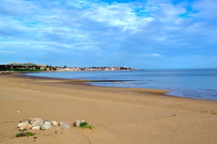
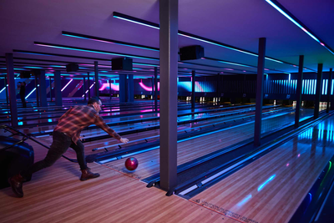
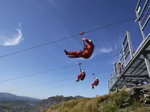
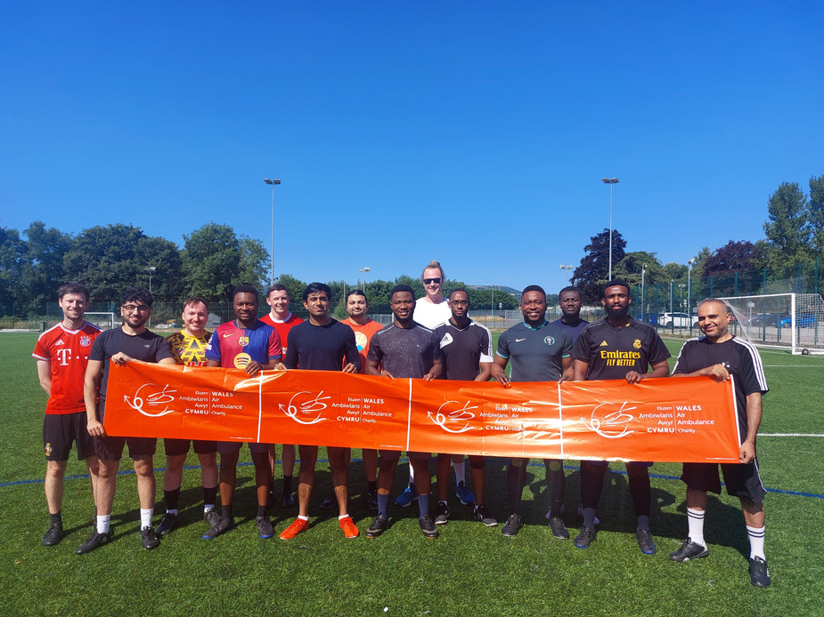
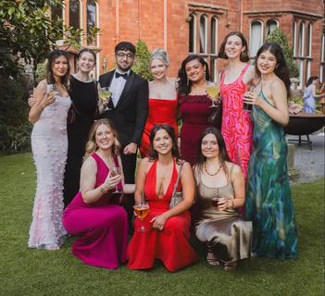

MUST KNOWS
Glan Clwyd
Life In North Wales
Nature
North Wales is blessed with some of the most beautiful views and hikes. Below is a list of the ‘must-see’ places over the two years! There are so many more places than listed, but here are some to start...
Hikes / Walks
Snowdonia
Moel Famau
Betws-Y-Coed
Aber Falls
Great Orme
Sites
Beaches
Conwy Castle
Bodelwyddan Castle
Portmeirion
Bodnant Gardens
Dyserth Falls
Llandudno Pier
Colwyn Bay
Morfa Beach
Rhos-on-Sea
Activity
Whilst there is not as many things as a city, Wales still offers some good activities! Please note, you will likely need to drive or get public transport to most things.
ZipWorld - outdoors adventure park
Pictura Chester - pottery painting
River Dee Kayaking
Welsh Mountain Zoo
TenPin Chester - Bowling, arcade, lasertag
Ice Skating - Deeside Leisure
BCDS
BCDS (Betsi Cadwaladr Doctor Society) was set up in 2024 to help people new to the area get the chance to explore as well as socialise with their new colleagues. Foundation doctors and PAs make up a large part of the society, but everyone is welcome to all of our events!
Our events include charity football matches, an Annual Ball, charity hikes, bonfire night, paint & sip, pub crawls, etc... basically something for everyone!
Follow us on @betsi.doctors.society for our events!
28

