Slide 1
Canllaw i Feddygon Sylfaen sy’n Dechrau ym mis Awst 2025
A Guide for Foundation Doctors
Commencing August 2025

Slide 2
Croeso Welcome
We aim to ensure that you enjoy your time as a Foundation Doctor with the Wales Foundation School and have written this guide so you are aware of what you can expect and what is expected of you. This guide contains just some of the key information that you will need throughout your Foundation training. In addition to the guide, the Wales Foundation School will send monthly email bulletins and other updates (please keep us updated with your personal email address).
Your local Foundation Programme Director and Foundation Administrator will provide key local information throughout the Programme, but should you have any queries, the team in the Wales Foundation School are only too happy to help. Please visit our website https://heiw.nhs.wales/education-and-training/foundation/
If you are unable to find the answer on our website, please contact HEIW.FoundationSchool@wales.nhs.uk

Slide 3
Pobl hollbwysig Key people
UK Foundation Programme Office (UKFPO)
Wales Foundation School (WFS) – part of Health Education Improvement Wales (HEIW)
NHS Wales Shared Services Partnership (NWSSP) – the Single Lead Employer
Foundation Programme Directors (FPDs) and Foundation Administrators (FA) – within your "host organisation"
Educational and Clinical Supervisors (ES and nCS) – linked to your allocated placements

Slide 4
Swyddfa Rhaglen Sylfaen y DU (UKFPO)
Foundation Programme Office (UKFPO)
The UKFPO facilitates the operation and continuing development of the Foundation Programme, including;
Issuing guidance on Foundation training and promoting consistent delivery across the UK,
Managing the overall recruitment process to the Foundation Programme, and
The development and production of the UK Foundation Programme Curriculum.
For further information on the UKFPO, please visit https://foundationprogramme.nhs.uk

Slide 5
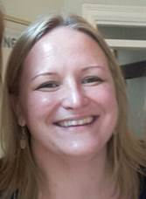
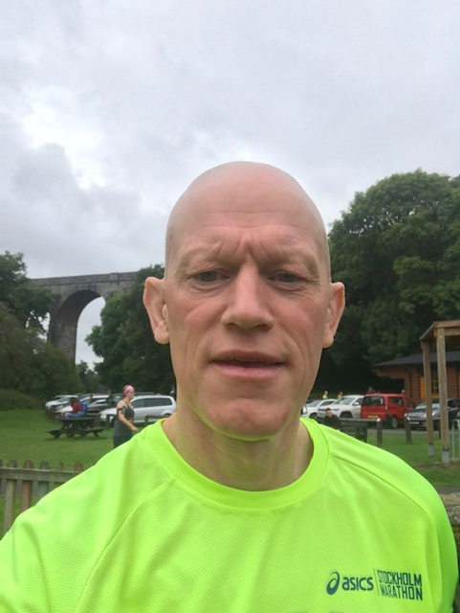
Tîm Ysgol Sylfaen Cymru
Wales Foundation School Team
Prof Tom Yapp | Dr Esyld Watson
Foundation School Director | Deputy Foundation School Director
Health Education Improvement Wales (HEIW) | Accident & Emergency Consultant, Prince Charles Hospital

Slide 6
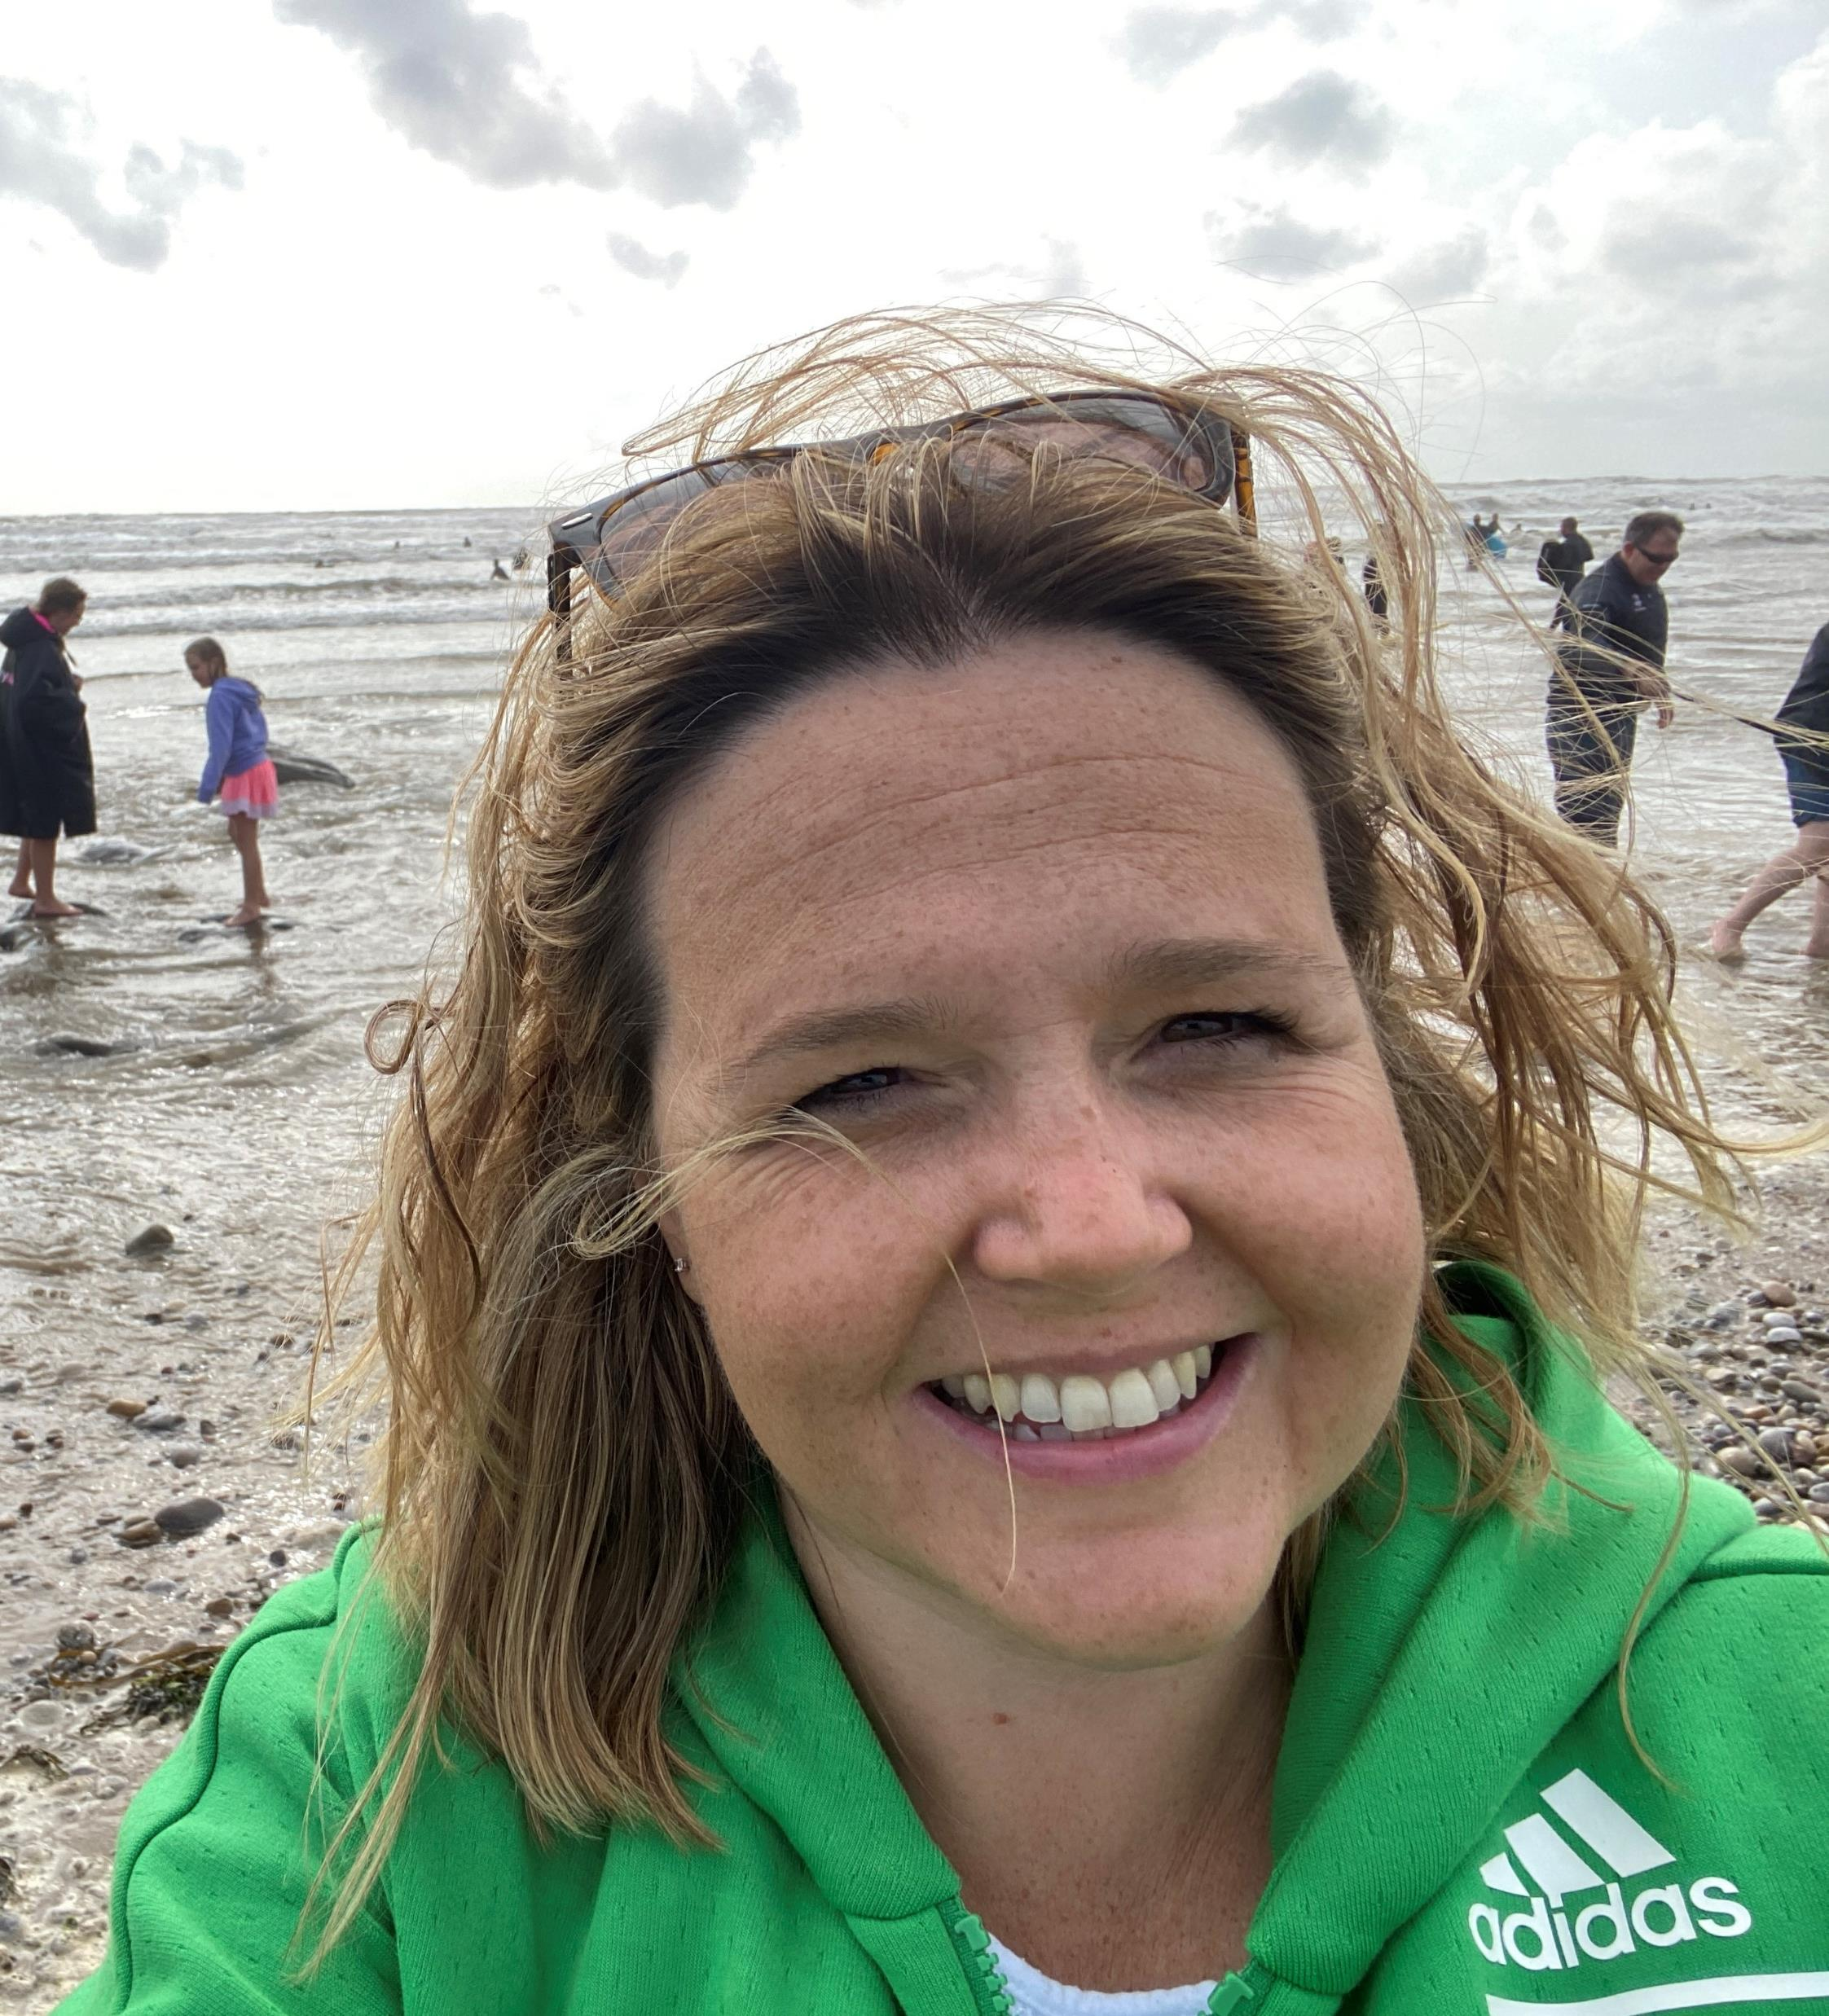
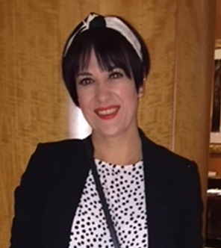
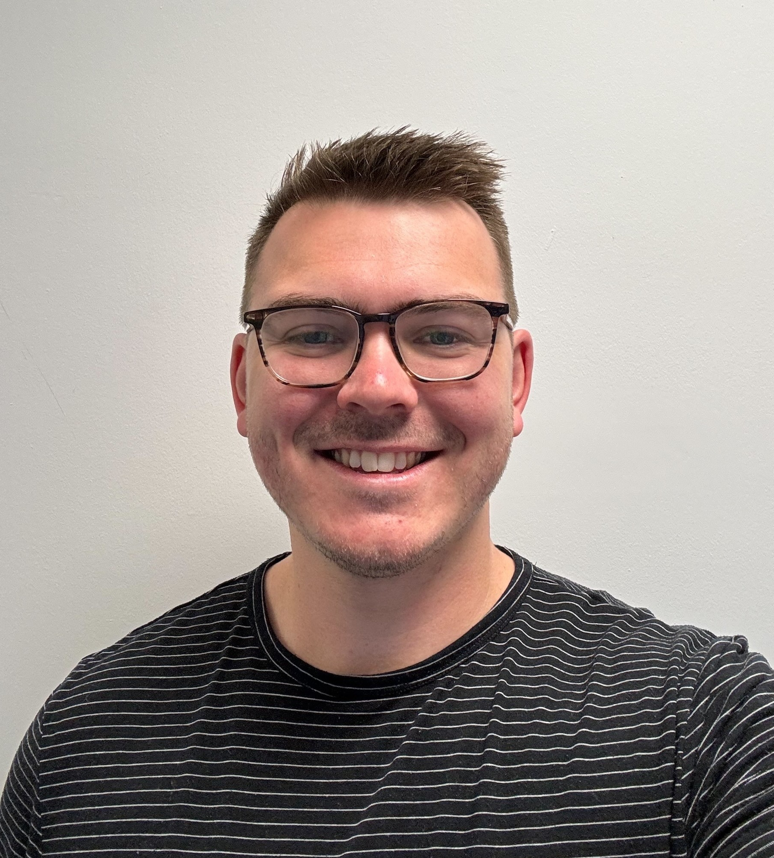
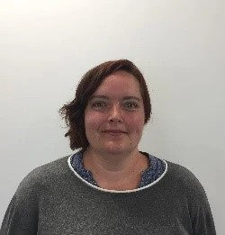
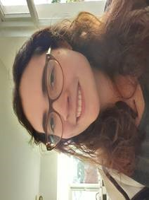
Tîm Ysgol Sylfaen Cymru
Wales Foundation School Team
Joanne Huish | Sioned Edwards | Sarah Sanders | Thomas Hunt | Mairead Geaney
Foundation School Manager | Foundation Manager (Trainee Progression) | Foundation Manager (Programme Management) | Administrative Officer (Trainee Progression) | Administrative Officer (Programme Management)
Contact us at heiw.foundationschool@wales.nhs.uk

Slide 7
Partneriaeth Cydwasanaethau GIG Cymru (NWSSP)
NHS Wales Shared Services Partnership (NWSSP)
NWSSP will be your employer for the duration of your Foundation training.
You can contact them directly via NWSSPSLE.Foundation@wales.nhs.uk if you have any employment related questions, such as:
Pay
Contracts/proof of employment
Expenses (via www.sel-expenses.com or NWSSP.TrainingGradeExpenses@wales.nhs.uk)
Relocation & Excess Travel claims (require submission of a form prior to claiming- https://nwssp.nhs.wales/ourservices/employment-services/all-wales-relocation/)
Banding queries (these are dealt with in conjunction with your host organisation)

Slide 8
Cyfarwyddwyr Rhaglen Sylfaen (FPD) a Gweinyddwyr Sylfaen(FA)
Foundation Programme Directors (FPD) & Foundation Administrators (FA)
In addition to the Foundation School team, there are Foundation Programme Directors (FPDs) based in hospitals across Wales.
Each FPD is assisted by a local Foundation Administrator (FA), usually within the Postgraduate Centre (PGC). Contact details have been provided within your "Welcome to Wales" email from the Foundation School.
The FPDs' responsibility is to ensure that a quality programme is being delivered within their region, and that each Foundation doctor is adequately supervised throughout their training.
The FPD may also provide additional individual support if required.

Slide 9
Sefydlu Rhaglen Sylfaen (FPD) a Gweinyddwyr Sylfaen (FA)
Foundation Programme Directors & administrators
Region | Hospital | FPD | FA
Betsi Cadwaladr (West) | Ysbyty Gwynedd, Bangor | Dr Ushan Andrady Dr Emyr Huws | Angela Charlton
Betsi Cadwaladr (Central) | Ysbyty Glan Clwyd, Rhyl | Dr Eve Blakemore | Elaine Hughes
Betsi Cadwaladr (East) | Wrexham Maelor, Wrexham | Dr Chethan Padmanabhaiah | Suzanne Hulmes
Hywel Dda (Cered.) | Bronglais Hospital, Aberystwyth | Mr Simone Sebastiani | Shelley Williams
Hywel Dda (Pembs.) | Withybush Hospital, Haverfordwest | Dr Antony Mathew | Louise Owen
Hywel Dda (Carms.) | Glangwili General Hospital, Carmarthen Prince Philip Hospital, Llanelli | Dr Jo McCarthy Dr Adam Tyler Mr Islam Abdelrahman | Rhiannon Taylor Kerry Rees
Swansea Bay | Morriston Hospital, Swansea Singleton Hospital, Swansea | Dr Ritu Nirula Dr Rhodri Edwards | Bethany Jones Julie Tucker (interim)
Cardiff & Vale | University Hospital Wales, Cardiff | Dr Rachel Rayment Dr David Owens | Sharon Goodwin
Cwm Taf Morgannwg (West) | Princess of Wales Hospital, Bridgend | Dr Abby Parish | Claire Laidler
Cwm Taf Morgannwg (North) | Prince Charles Hospital, Merthyr Tydfil | Dr Marcia Scheller | Donna Morgan
Cwm Taf Morgannwg (South) | Royal Glamorgan Hospital, Pontyclun | Mr Sam Fishpool | Sarah Bechares
Aneurin Bevan | Royal Gwent Hospital, Newport Nevill Hall Hospital, Abergavenny | Dr Ashok Vaghela Dr Helen Fowles Dr Jennifer Rankin | Caroline Newman (interim)

Slide 10
Goruchwyliaeth Addysgol a Chlinigol
Educational and Clinical Supervision
You will be assigned to an Educational Supervisor (ES) at the start of your F1 and F2 year, which will be for the duration of that year.
For most programmes, your ES will also be your Clinical Supervisor (nCS) for your first 4-month placement. However, for GP LIFTs, your GP Supervisor may instead be your ES.
For each of your placements (including LIFT) you will also have a nCS.
You should meet with your ES at the beginning of each year, and at the end of each placement, as a minimum. The meeting towards the end of your final placement of the year will be to complete the “End of Year Report” ready for ARCP. This should be done in May for the June ARCPs.
Your ES will liaise with your nCSs throughout the year to review your progress and both will complete summative assessments for your portfolio, in the form of “End of Placement” Educational Supervisor, Clinical Supervisor or Combined Reports.

Slide 11
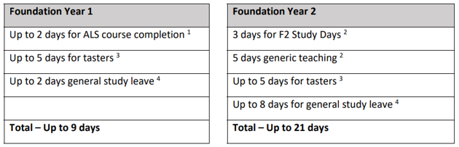
Absenoldeb Astudio
Study Leave
Study Budget Entitlement:
£250 for specialised F1s only
£480 for F2s
Study Leave entitlement is split between your F1 and F2 year, with recommendations for what the leave can be used for.
Please note in F1 your ALS course will be arranged for you, and in F2 the Study Days and Generic Teaching will also be pre-determined.
All other leave can be taken at the approval of your supervisor; however, we ask that the
days are spread equally across placements when possible.

Slide 12
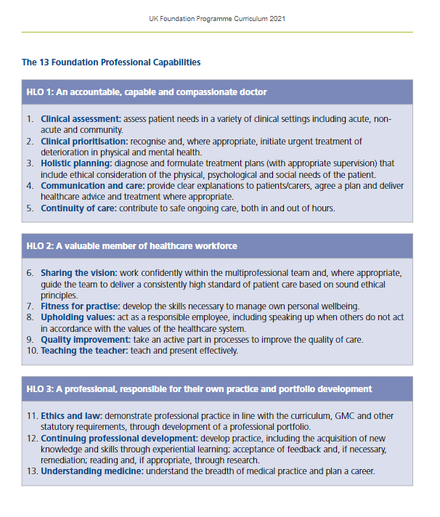
Cwricwlwm Sylfaen
Foundation Curriculum
All Foundation Doctors will follow the 2021 Foundation Curriculum. The curriculum is made up of 3 Higher Learning Outcomes (HLOs), which must be demonstrated by meeting each of the 13 Foundation Professional Capabilities (FPCs).
An interactive copy of the Curriculum can be found on the UKFPO website.
In addition to the Curriculum a number of resources, including a series of YouTube videos, podcasts and factsheets can be found on the UKFPO website.

Slide 13
eBortffolio Dysgu Sylfaen (Turas)
Foundation Learning ePortfolio (Turas)
To record evidence to satisfy the ARCP panel, you will use an electronic portfolio called Turas.
Turas can be accessed at: https://turasportfoliowales.nes.digital/ and you should have already received an email with your login details so that you may access your account prior to commencement.
There is also some guidance available on the Scotland Foundation School website.
Should you experience any difficulties accessing or using the system, advice can be sought from your local FA in the first instance.
Please remember, it is your responsibility to maintain and develop your ePortfolio as a record of your professional development.

Slide 14
e-Ddysgu ar gyfer Gofal Iechyd (eLfH) e-Learning for Healthcare (eLfH)
In addition to Turas, you will also have access to the e-Learning for Healthcare (eLfH) portal.
eLfH is a Health Education England Programme in partnership with the NHS and Professional Bodies providing high quality content free of charge for the training of the NHS workforce across the UK.
You will have been emailed your log in details for this directly from eLfH. The email used for the eLfh account is the same email that was used to register with the GMC.
You can also register yourself at the following: http://portal.e-lfh.org.uk/register
Further information on this can be found using this link http://www.e-lfh.org.uk/home/
Should you have any queries about access to your e-learning account, please contact https://support.e-lfh.org.uk/

Slide 15
Amser hunanddatblygu (SDT)
Self-development time (SDT)
This is time included within your job plan that should be used for non-clinical activities required to develop as a Foundation Doctor. Examples of this would be;
Preparing or Delivering teaching
Non-Core Learning
Quality Improvement activity
Career exploration or research
Applications
Supervisor meetings or updating your ePortfolio
Foundation Year | SDT per week
F1 | 1 hour
F2 | 3 hours
Pro-rata for LTFT trainees

Slide 16
Amser hunanddatblygu (parhad)
Self-development time (continued)
This time is self-directed; however, areas of focus may be suggested by your supervisors and all SDT should take place within the clinical setting.
This time is not intended to replace time already available in schedules for non-clinical work, such as Study Leave or departmental meetings.
There is an expectation that the commitment to SDT will be met by the local health boards however, there may be times when other duties take precedence.
SDT can be consolidated with the approval of your supervisor (e.g. an F1 taking 4 hours per month).
However, it is not envisaged that SDT missed due to annual leave or study leave will be carried forward.

Slide 17
Diwrnod Cyflwyniadau Cenedlaethol Meddygon Sylfaen 2026
National Foundation Doctors Presentation Day 2026
A day of oral and poster presentations submitted, presented and attended by F1 and F2 doctors, as well as representatives from Foundation Schools, the GMC, BMA and Medical Schools Council.
The upcoming event will be held in January 2026, and the location is to be confirmed. Abstract submissions will open in early October 2025
Further information for 2026 can be found on the UKFPO’s website
Information on previous events can be found here

Slide 18
Adolygiad Blynyddol o Gynnydd Cymhwysedd(ARCP) Annual Review of Competence Progression (ARCP)
Towards the end of your F1/F2 year, an ARCP panel will be convened, to review your progress. Details of the ARCP process can be found on the UKFPO website.
The main ARCP Panels will be held in June 2026, so you will only have until the end of May (partway through your 3rd placement) to populate your ePortfolio with evidence to meet the requirements for sign off.
If you are training “out of sync” (i.e. you will not be completing your F1 or F2 training in August) you will be given a “No Review” (N-) code in June and have a subsequent ARCP at your transition point. Ad hoc information will be provided for those impacted.

Slide 19
Rhestr Wirio ARCP
The ARCP Checklist
The UKFPO curriculum requirements for successful ARCP sign off can be found on their website.
In addition, the Wales Foundation Programme also requires:
Successful completion of Advanced Life Support (ALS) in F1
A completed “End of Placement Evaluation Form” (EPEF) for each 4-month placement.

Slide 20
Asesu yn ystod Hyfforddiant Sylfaen
Assessment during Foundation Training
The tools below will be used to inform your FPD, ES, and nCS of your progression and aid the completion of your placement reports. Each of these areas are described briefly in this document, but you are strongly advised to read the Curriculum or watch the UKFPO’s videos for further information.
Attendance record
Multi-Source Feedback (in the form of a PSG and TAB)
Regular completion of the SLEs to demonstrate learning
Regular reflections/completion of the summary narrative
Satisfactory attendance at delivered ‘core’ and ‘non-core’ learning.
Engagement with the programme (i.e. maintenance of a contemporaneous e-portfolio, participation in feedback on training, and completing the necessary records for revalidation)
Passing the required qualifications (i.e. PSA and ALS for F1)

Slide 21
Absenoldeb o Hyfforddiant
Absence from Training
The Foundation Programme is both time and competency-based.
Total absences of more than 20 working days (excluding annual and study leave) within a training grade will trigger a review to assess if a period of additional training time is needed, as per the GMC position statement on absences.
Absences (such as sick, parental or compassionate leave) should be recorded in your e-portfolio throughout the year. Please ensure that you inform your local FA and NWSSP (via the self-reporting app) of any absences, as well as following any departmental absence reporting procedures.
The GMC position statement on absences can be found on the GMC website.

Slide 22
Hyfforddiant Llai na Llawn Amser (LTFT)
Less than Full Time Training (LTFT)
Information on Less than Full Time Training can be found on the HEIW website. This policy has been recently updated.
Please note that if you chose to work Less than full time your Foundation Programme will be extended pro rata, and your pay will be impacted.
Whilst the on-call rota falls under the remit of the Health Board, it is usual that your rota would be reduced pro-rata (unless other reasonable adjustments are requested alongside LTFT), and your pay banding recalculated.
Those with a LIFT placement may have this removed if their requested non-working days clash with the planned LIFT day.
Those undertaking an SFP would have their SFP time pro-rata’d, and it would not usually be extended past the planned calendar year.

Slide 23
Grŵp Goruchwylio Lleoliadau (PSG)
Placement Supervision Group (PSG)
We recommend that this is completed in your first F1 or F2 placement.
Your nCS will identify a group of senior healthcare professionals to make up a ‘Placement Supervision Group’ as part of your initial meeting and will then send out feedback requests towards the end of the placement.
The purpose of the PSG is to provide constructive senior feedback on your performance, which will be rated as Satisfactory or Unsatisfactory by your nCS.
A satisfactory PSG is required for completion of your training. If problems are identified within the initial PSG, another will need to be carried out in a following placement.
Further information on the make up and role of the Placement Supervision Group can be found on the UKFPO website.

Slide 24
Asesiad Tîm o Ymddygiad (TAB)
Team Assessment of Behaviour (TAB)
TAB is a multi-source feedback tool to help you, and your ES, understand how you are viewed professionally by your colleagues. Further information on the TAB can be found on the UKFPO website.
We recommend the TAB is completed in your second F1 or F2 placement, although some placements may struggle to obtain the required split of respondents so you should confirm whether this should be varied for your rotation with your nCS.
Feedback should be requested by you via the ePortfolio and a self-assessment also completed. This is then reviewed and rated Satisfactory/Unsatisfactory by your nCS.
It is recommended that a TAB is completed 10 weeks after your placement starts (in your 3rd placement this may result in an Outcome 5 due ARCP timing).
Placement | TAB created | Response Submission deadline
Placement 1 (if required) | 2nd week of October | End of October
Placement 2 (expected) | 2nd week of February | End of February
Placement 3 (if required) | 2nd week of June | End of June

Slide 25
Digwyddiadau dysgu dan oruchwyliaeth (SLEs)
Supervised learning Events (SLEs)
SLEs are used to provide a more formal way of recording feedback, and to allow it to be presented within the ePortfolio at ARCP, as evidence to support your progress against the curriculum. The following SLEs are used in the Foundation Programme:
CBD – case-based discussion: the discussion of a case presentation after an (unobserved) encounter in the workplace environment
DCT – developing the clinical teacher: used for feedback on a formal teaching session or presentation the doctor has delivered
DOPS – direct observation of procedural skills: completion of which should, ideally, include observation of the explanation to the patient of why the procedure is being performed, the process of consent including an understanding of complications, and technical capability of the procedure itself
LEADER – for recording feedback following an event where the doctor has used leadership skills
LEARN – learning encounter and reflection note: suitable for recording the other examples listed and other forms of evidence, such as performance in simulation
Mini-CEX – mini clinical evaluation exercise: direct observation of the doctor undertaking an interaction while at work on the ward

Slide 26
Myfyrdod Boddhaol/Naratif Cryno
Satisfactory Reflection/Summary Narrative
Reflection forms can also be created by the doctor to demonstrate achievements or self improvement, and can be mapped to specific HLOs on the Curriculum. These are set as private on your ePortfolio until they are shared with your supervisors.
The Summary Narrative is another form of written reflection intended to assist your ES (and eventually the ARCP panel) in identifying your progress and curriculum achievements. This will be reviewed in conjunction with the evidence links mapped against the 14 FPCs of the curriculum.
This should be initiated towards the end of your 1st placement and updated towards the end of each placement until your ARCP. There is a 300-word limit for each HLO.

Slide 27
Dysgu creiddiol a dysgu nad yw'n greiddiol
Core & Non-Core learning
Core learning sessions will be delivered by your local Foundation Team, and you will be informed of these sessions once you commence the Foundation Programme. These will be in the form of generic teaching in F1, and generic teaching/Study Days in F2.
Core Learning should make up at least 30 hours of your combined learning for the year.
You will also be expected to take part in other Foundation relevant learning activities (including self-directed learning), which should bring your total learning log up to 60 hours.
All learning should be logged in your ePortfolio.
Details of the learning categories (and exclusions) can be found on the UKFPO’s website.

Slide 28
Ymgysylltu â'r rhaglen
Engagement with the programme
For successful completion of your F1/F2 year you must demonstrate engagement with the programme, through the following:
Regular and appropriate engagement with your ePortfolio.
Participation in feedback on training, through:
  Completion of End of Placement Evaluation Forms (EPEFs) for each 4-month placement (these forms can be found on the ePortfolio).
  Completion of the annual GMC survey (in March each year).
Meeting requirements for Revalidation:
  Completion of a Form R in preparation for your ARCP.

Slide 29
Asesiad Diogelwch Rhagnodi (PSA)
Prescribing Safety Assessment (PSA)
F1 only
If you have passed the PSA in the 2 years prior to starting the Foundation Programme, this will be confirmed on Turas in bulk in August by the Foundation School.
The PSA certificate can be uploaded once a pass has been confirmed, and should be done in preparation for your ARCP.
If you need to sit or resit the PSA, the Foundation School will be in touch with the arrangements for these sittings.
The first assessment will be held on Wednesday 15th October 2025

Slide 30
Cymorth Bywyd Uwch (ALS)
Advanced Life Support (ALS)
F1 only
One sitting of the ALS course will be funded by the Foundation School for each doctor who has not already achieved this.
Please refer to our ALS Course Funding Policy for further information
The courses are held locally and will be arranged by your local Postgraduate Centre.
If you do not successfully complete the funded course, you will need to fund any subsequent resits personally.

