Slide 1
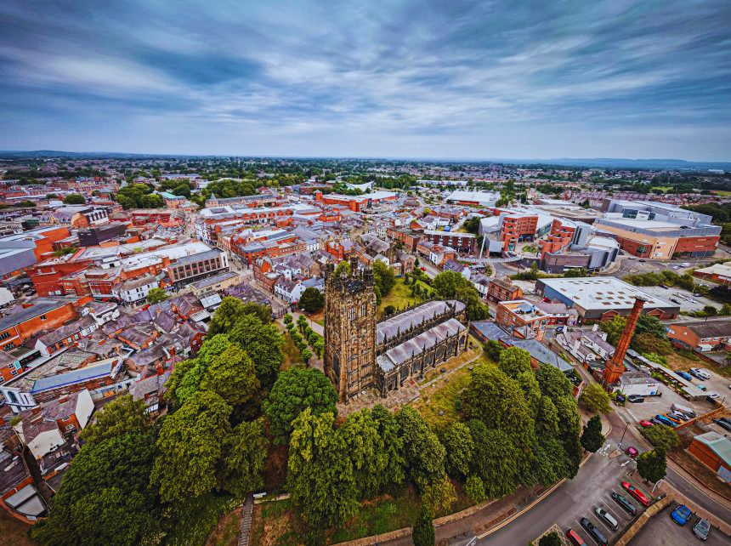



Welcome To Wrexham!
Wrexham Maelor Hospital
Foundation Programme
WRECSAM
MEDED
WREXHAM

Slide 2
03.
About Wrexham
08.
Betsi Cadwaladr University Health Board
11.
Wrexham Medical Institute
12.
Health and Wellbeing
CONTENTS
14.
Library
15.
Doctor’s Mess
16.
Free Accommodation for F1's
17.
Testimonials and Feedback
19.
Contact Details
WRECSAM
MEDED
WREXHAM
Page 2

Slide 3
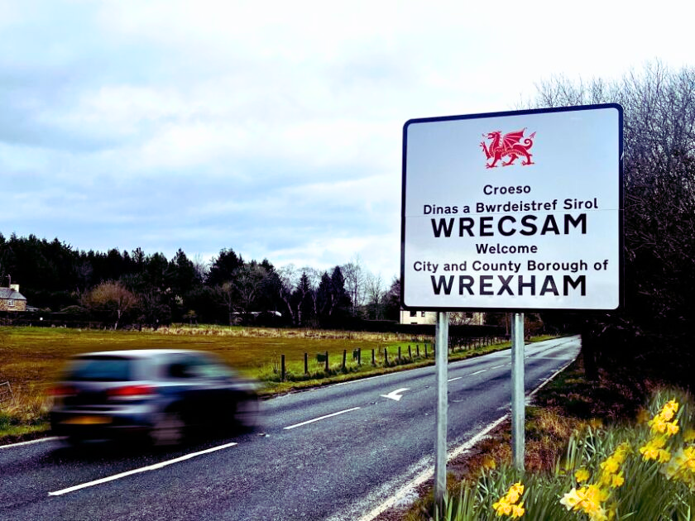
About Wrexham & The Surrounding Area
Wrexham is ideally located in North East Wales, in easy reach of a number of locations locally and nationally. We are the largest settlement in the area, and many residents commute into Wrexham from the local area for work. Situated on the A483, we are connected directly by road to the North of England and South Wales. We are approximately a 45 minute drive from Liverpool, 1 hour from Manchester, 1 hour 30 minutes from Anglesey and 3 hours from Cardiff. There are a number of other major roads which pass close by and are easily accessible.
Wrexham has the luxury of two train stations, both of which are a 10 minute walk from the hospital. Wrexham Central provides a small number of services to Merseyside and the Wirral. The larger Wrexham General provides regular services to Holyhead, Newport, Cardiff, Birmingham, Chester, London Euston and Shrewsbury amongst other destinations.
WRECSAM
MEDED
WREXHAM
Page 3

Slide 4
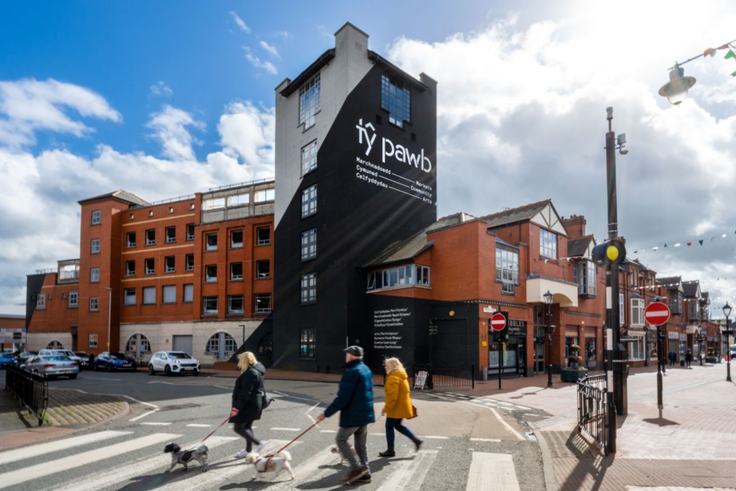
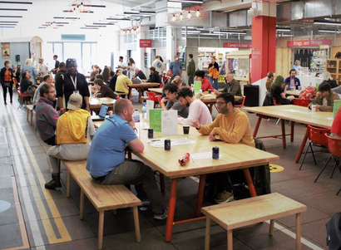
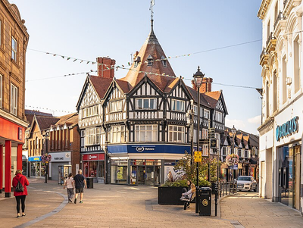
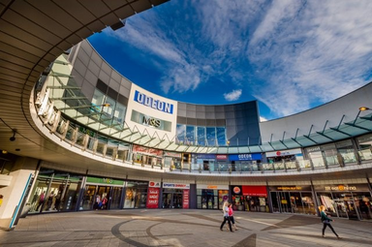
Wrexham City Centre
There are gyms galore, a variety of restaurants, cafés, takeaways and pubs including Ty Pawb which combines parking, shopping, art gallery and eateries under one roof! A market on a Monday for all your fresh produce. There is a variety of activities in the City throughout the year including the yearly Wrexham Food Fest and the Christmas Market.
Eagles Meadow complex plays home to a number of fashion and retail outlets. Most shops are open until 5:30pm weekdays and weekends. Eagles Meadow also hosts an Odeon cinema, as well as tenpin-bowling. With the increase in fame of the towns football club don’t be surprised to see Hugh Jackman or Will Farrell walking around the city and enjoying a pint before the game in the local pub!
WRECSAM
MEDED
WREXHAM
Page 4

Slide 5
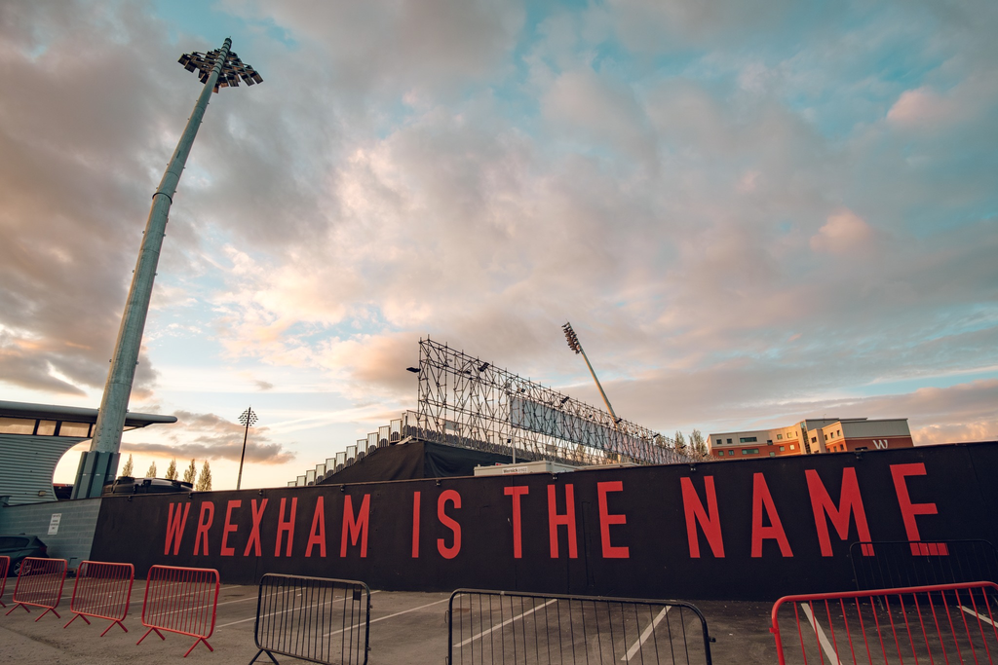

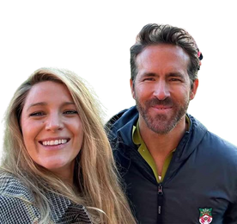
Wrexham AFC
Wrexham Association Football Club is a professional association football club based in Wrexham, Wales. Formed in 1864, it is the oldest club in Wales and the third-oldest professional association football team in the world.
The “Welcome to Wrexham” documentary on Disney is well worth a watch, and showcases the spirit and sense of community Wrexham has to offer.
WRECSAM
MEDED
WREXHAM
Page 5

Slide 6

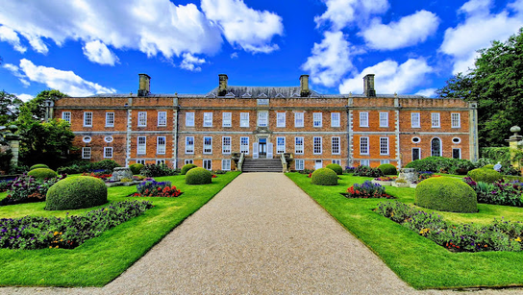
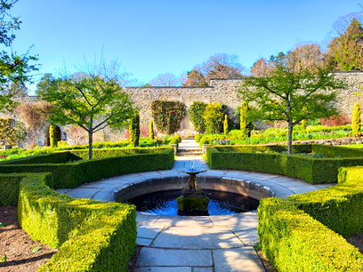
Explore the Beautiful Countryside
If you had a more relaxed pace in mind, why not pay a visit to the nearby Pontcysyllte Aqueduct. Internationally renowned as a World Heritage Site, the Aqueduct carries the Llangollen canal and was built in 1805 by Thomas Telford. The iron channel which carries canal boats has a walkway on one side only, with a sheer 126ft drop on the other side. It can be a nerve wracking experience crossing the aqueduct, but one which is worth it for the outstanding views of the surrounding valley! Or visit Erddig country house and enjoy a stroll trough the beautiful gardens and surrounding countryside. All right on your doorstep!
WRECSAM
MEDED
WREXHAM
Page 6

Slide 7
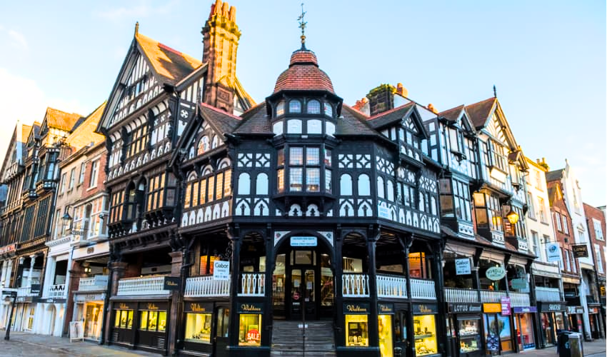
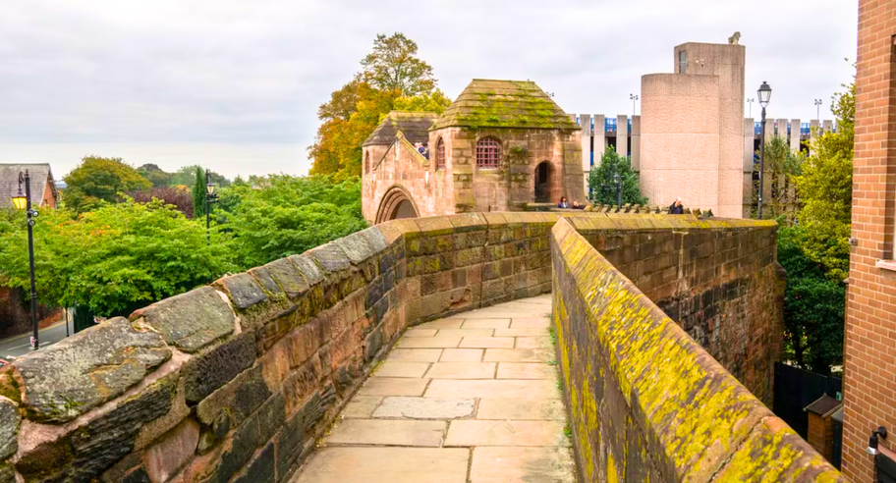
Nearby Cities
Wrexham is ideally located close to the city of Chester. Many of the current F1s visit Chester on a regular basis. Surrounded by its world-famous walls, the city began life as a Roman settlement, and ruins of many of the original buildings can still be seen today. There are many shopping facilities available for the avid shopper, and many restaurants call Chester home, ideal for the food fans amongst you. All of this set amongst the numerous medieval buildings. The main streets in Chester have an interesting layout, with 2 rows of shops/outlets/eateries set one above the other in the famous “rows”.
WRECSAM
MEDED
WREXHAM
Page 7

Slide 8

Working at Betsi Cadwaladr University Health Board
Betsi Cadwaladr University Health Board is the largest health organisation in Wales, providing a full range of primary, community, mental health and acute hospital services for a population of around 676,000 people across the six counties of North Wales (Anglesey, Gwynedd, Conwy, Denbighshire, Flintshire and Wrexham) as well as some parts of mid Wales, Cheshire and Shropshire.
The Health Board employs around 16,500 staff and has a budget of around £1.2billion. It is responsible for the operation of three district general hospitals (Ysbyty Gwynedd in Bangor, Ysbyty Glan Clwyd near Rhyl, and Wrexham Maelor Hospital) as well as 22 other acute and community hospitals, and a network of over 90 health centres, clinics, community health team bases and mental health units. It also coordinates the work of GP practices and NHS services provided by North Wales dentists, opticians and pharmacies.
WRECSAM
MEDED
WREXHAM
Page 8

Slide 9
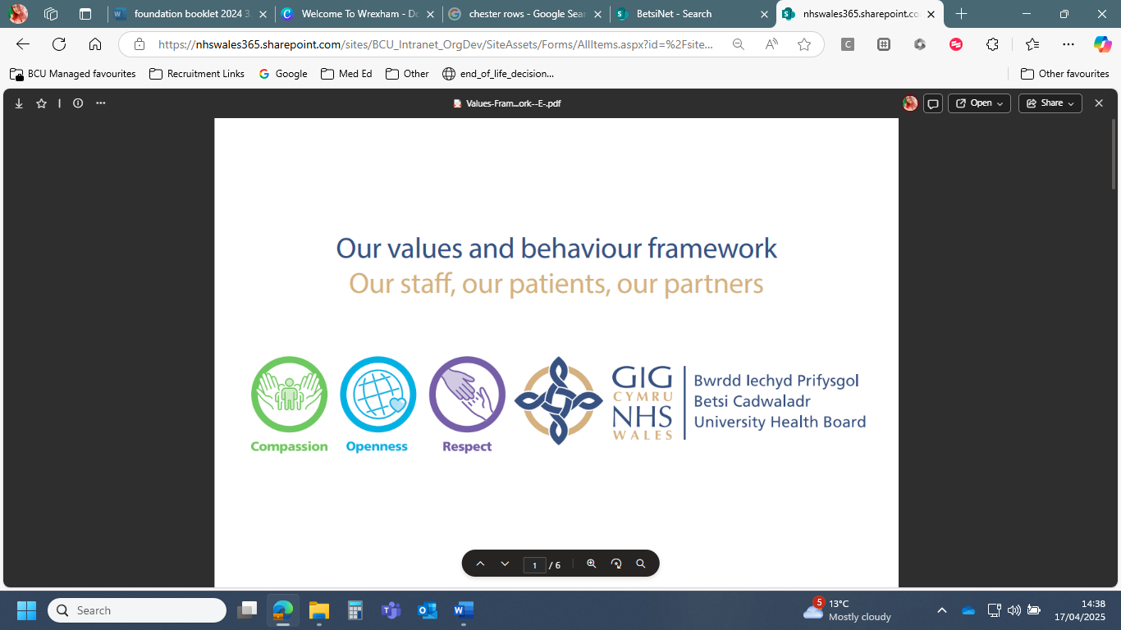
Our Values and Behaviour Framework
Our values and behaviours shape the way we work, how we interact with each other, our patients/service users and our partners. Values are beliefs or principles that are important and meaningful to us - they are what drives us.
Behaviours are what we observe, our actions that bring these values to life. Our behaviours demonstrate our values through what we say and how we say it, how we do things and how we treat others and expect to be treated ourselves.
WRECSAM
MEDED
WREXHAM
Page 9

Slide 10
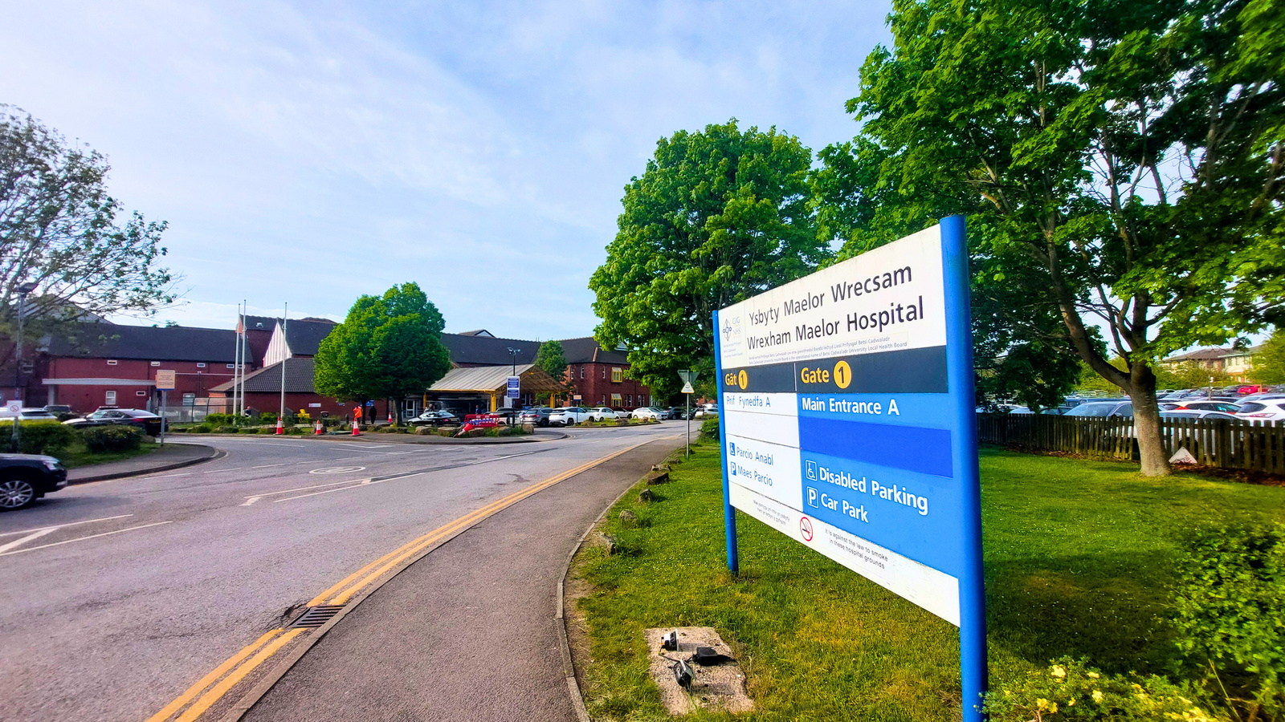
Why Wrexham Maelor?
Starting work as a foundation doctor can be both an exciting and daunting time. Choosing where to apply to work during the foundation programme can be a big part of this process. Here at Wrexham Maelor hospital, we believe that we provide the ideal environment for you to have a happy and successful start to your medical career.
As a reasonably sized district general hospital, we serve a large population in North-East Wales. One of the advantages we feel working in a DGH offers is a steady stream of general medical and surgical cases.
We are fortunate here in Wrexham to have friendly, welcoming staff who make our new doctors feel welcomed and valued. This, coupled with our proximity to Manchester, Liverpool and Chester means that our foundation trainees have a great experience both professionally and socially.
WRECSAM
MEDED
WREXHAM
Page 10

Slide 11
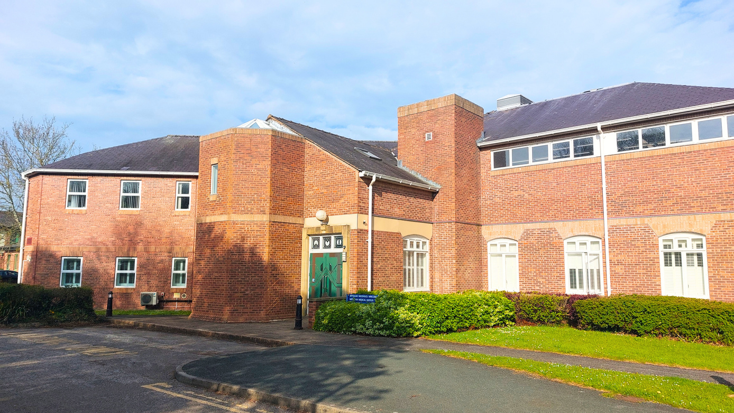
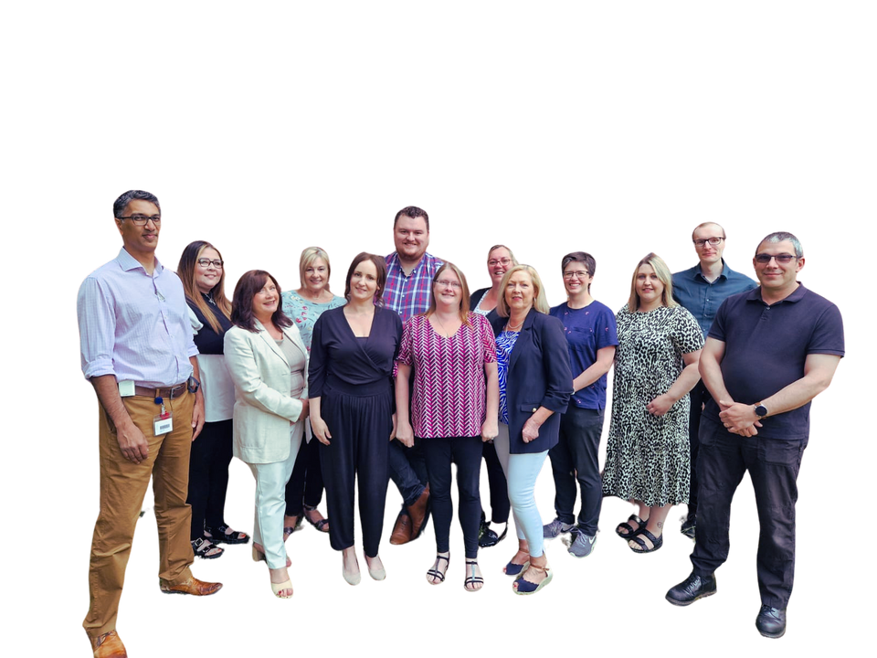
Wrexham Medical Institute
Medical Education Department
The team consists of the Medical Director for Medical and Dental Education, Clinical Director for Medical and Dental Education, Foundation Programme Director, Medical and Dental Education Manager, Operational Manager, three Lead Coordinators, one Coordinator, and two Reception/Admin Support Assistants. We also have some fantastic MedEd Fellows working across various specialties who support with Medical Education at Wrexham.
The Wrexham Medical Institute is located separately but not far from the main hospital giving you a little “time out” from the hustle and bustle. Our pastoral support has increased greatly within the last two years with the establishment of the Health and Well Being Support Service which as has gone from strength to strength with the health and wellbeing sessions proving to be popular especially the therapy dogs and Zumba classes!
WRECSAM
MEDED
WREXHAM
Page 11

Slide 12












Anything that matters to you, matters to us
Health & Wellbeing Support Service
Our Aim
Our aim is to provide a Health and Wellbeing service in order to support and guide our clinical professionals and support staff in East
Support and Guidance
The Health and Wellbeing coordinator is:
Someone you can speak to away from the hospital
Totally impartial and can help in many ways
One person you can contact regarding any concerns
Provides a confidential service
If they can not help, we have a list of professionals that can
Support Topics
Anything worrying you we want to know
Stress or depression
Bereavement
Health Concerns
Anxiety or Panic Attacks
Feeling Lonely
Family Matters
Long Term Illness
Any other worries
Reading resources
Who can access the service?
All Clinicians - any grade
Allied Healthcare Professionals
Physician Associates
Medical Students
Arts & Craft
Wellbeing
Days
Karen Price
Wellbeing we offer
Health and Wellbeing Coordinator
Therapy Dogs
Short Lectures
Exercise & Book Club
Karen.JonesPrice@Wales.nhs.uk
03000 847059
WRECSAM
MEDED
WREXHAM
Page 12

Slide 13
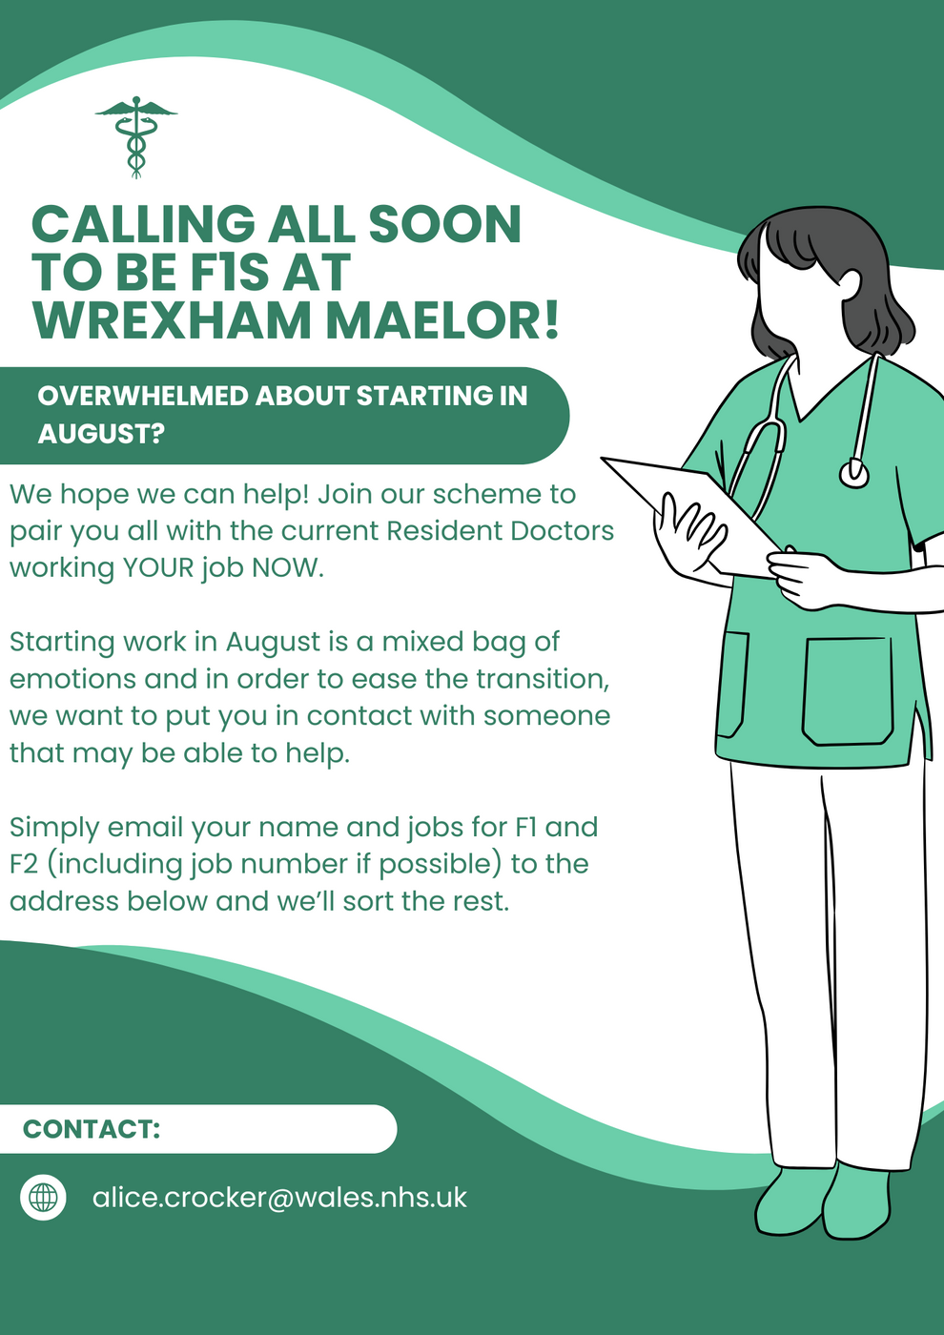
WRECSAM
MEDED
WREXHAM
Page 13

Slide 14
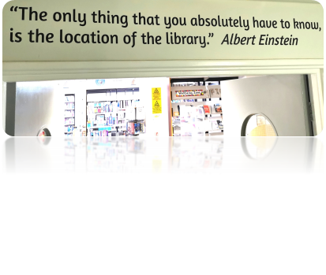
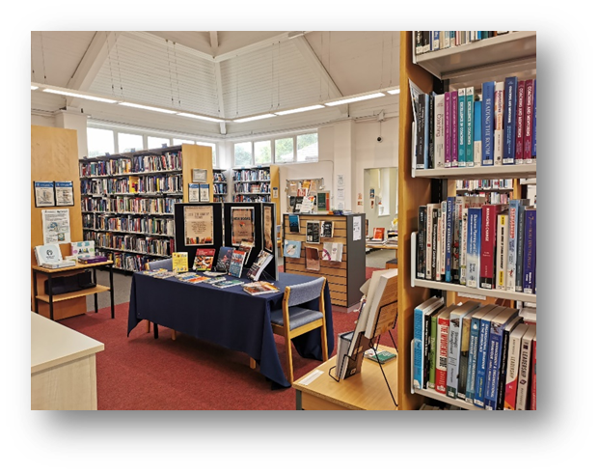
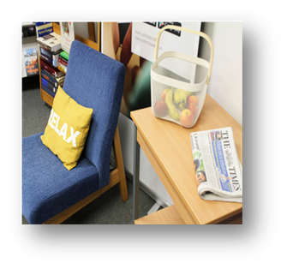
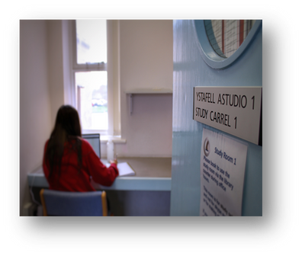
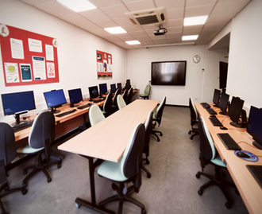
John Spalding Library
Located within the Wrexham Medical Institute is the John Spalding Library. ​The team consists of the Library Manager, a Librarian, and a Library Assistant. Access to the library is available 7am to midnight every day including weekends. It is staffed Monday to Friday.
The John Spalding Library offers a wide range of books for each speciality including revision exam books. As well as offering a range of services such as UpToDate, BMJ on examination vouchers, literature searching and information skills training. Their facilities include study spaces, designated quiet study areas, 2 computer rooms. There is also a well-being room. Printing and photocopying available free of charge.
WRECSAM
MEDED
WREXHAM
Page 14

Slide 15

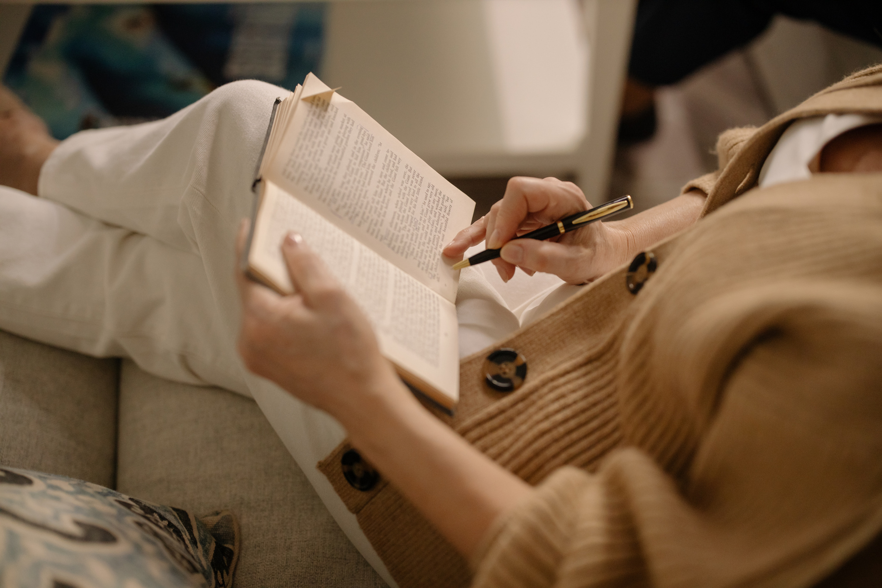


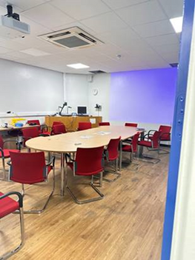
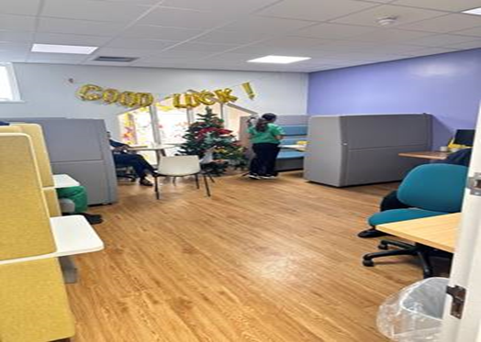
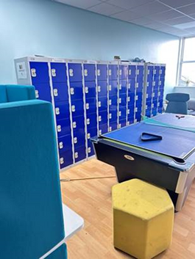
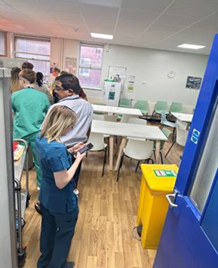
Doctor’s Mess
Located within the main hospital building on the first floor. The doctors mess has a space to relax, with large sofas, seating pods, televisions, computers, and you can even order your lunch to be delivered there!
There are also changing facilities, with showers, and lockers to store your personal belongings while on shift. It is a space where you can relax away from the hustle and bustle of the busy hospital. There are also regular events, and activities you can get involved with too.
I really enjoy how sociable the doctors mess is. We also have constant access to coffee and biscuits which is a game-changer. It’s a comfy spot to relax and recharge
WRECSAM
MEDED
WREXHAM
Page 15

Slide 16
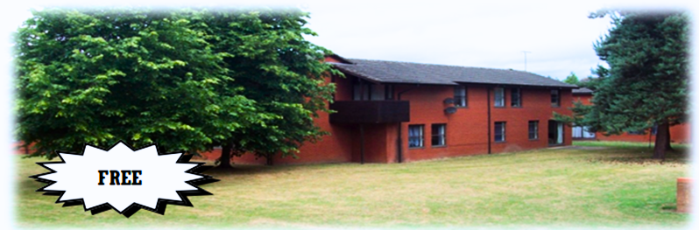
FREE Accommodation for F1's
As with all Hospitals throughout Wales, guaranteed accommodation is provided free of charge for all F1 doctors at Wrexham Maelor.
The accommodation is located within the main hospital site, but is situated across the road from main clinical buildings in a designated residential area. Most of the flats are home to five F1s who share a beautifully refurbished kitchen, bathroom, and toilet room and an amply-sized lounge. Each lounge has a free-view television.
Domestic service is provided weekdays but not weekend nor Bank Holiday periods. Shared laundry facilities are located within Bron-Y-Nant site although the newly refurbished flats will have their own washing and drying facilities and there is free car-parking on site.
Each of the bedrooms are well-sized and look out onto a garden area. They are also equipped with generous storage space, a single bed and a desk. Each room also comes with a built-in sink and running water facilities.
*Please note, couples and family accommodation is also available upon request although space may be limited.
For more information on what accommodation is available please get in contact with the local accommodation team:
Jane Jenkins
jane.jenkins@wales.nhs.uk
03000 848807
WRECSAM
MEDED
WREXHAM
Page 16

Slide 17
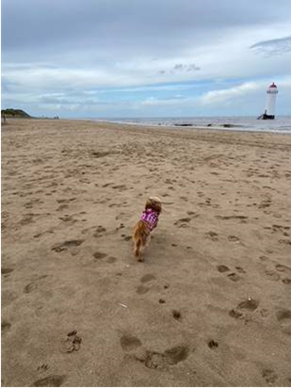
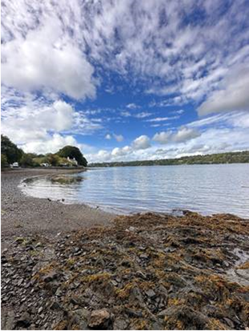
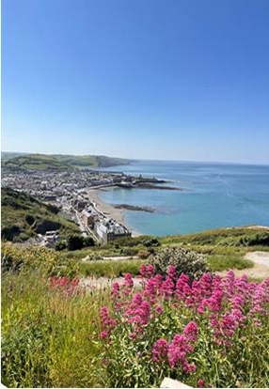

Testimonials & Feedback
Testimonial – Dr Inbar Aberman, Foundation Year 2 Doctor
Undergoing my Foundation Training at the Wrexham Maelor has been a brilliant experience. As an FY1, the learning curve is steep but at Wrexham, I found my consultants and registrars so approachable, supportive and keen to teach when they can. The wider healthcare team (especially the A&E and ward nurses) were so helpful and kind - you do feel like you’re working as a team for patient care and that’s always been a privilege here. My fellow foundation doctors have been there every step of the way and we were really lucky to have a very friendly cohort who help each other out often and support each other.
I undertook an FY1 which included a LIFT programme (one day a week at GP) and the opportunities to observe and work independently as an FY1 were excellent. As an FY2, I’ve taken on an SFP in Clinical Research one day a week which also runs alongside my FY2 job commitments - this has been a unique and challenging experience which has taught me about the wider spectrum of medicine outside the hospital. Most of the time, even in today’s challenging NHS climate, everyone has done their best to make us feel welcome, help us develop our skills and teach us whenever they could. Importantly, when things aren’t going so well, I’ve found that Wrexham as a working environment is very supportive and the faculty, consultants and rota team do try their best to help us whenever they can do so. Outside of hospital life, we do have festive holiday events and gatherings. We are well located close to some beautiful areas of North Wales - particularly if you love climbing, travelling or camping, so do take full advantage of this. On the other side of us, we are close to Manchester, Liverpool and Chester which are also great fun for music, shopping and exploring.
I can honestly say I couldn’t imagine training anywhere else. I hope you all enjoy Wrexham!
WRECSAM
MEDED
WREXHAM
Page 17

Slide 18



Testimonials & Feedback
Having amazing consultants that are very knowledgeable and happy to teach at all times. They always encouraged us to join them in clinic and learn as much as we can.
I learned more and gained more independence, enhancing my clinical and communication skills. This placement exposed me to the importance of holistic medicine in patient care. I was supported and always had someone senior to guide me.
Thoroughly enjoyed this post and have learned a lot from my time. Would be very happy to stay for a further 4 months in order to spend more time with the team, begin undertaking more independent practice and to further expand my skills and experience. Would highly recommend.
I absolutely loved this placement and will be very sad to leave! Thank you
Having amazing consultants that are very knowledgeable and happy to teach at all times. They always encouraged us to join them in clinic and learn as much as we can.
WRECSAM
MEDED
WREXHAM
Page 18

Slide 19


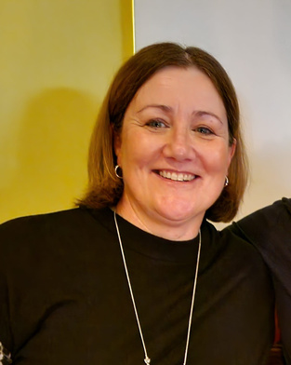
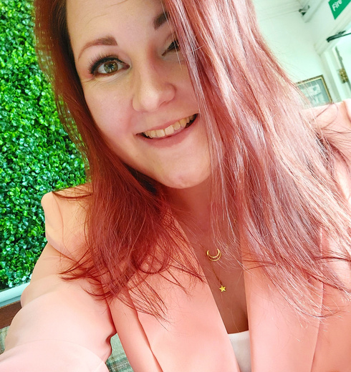
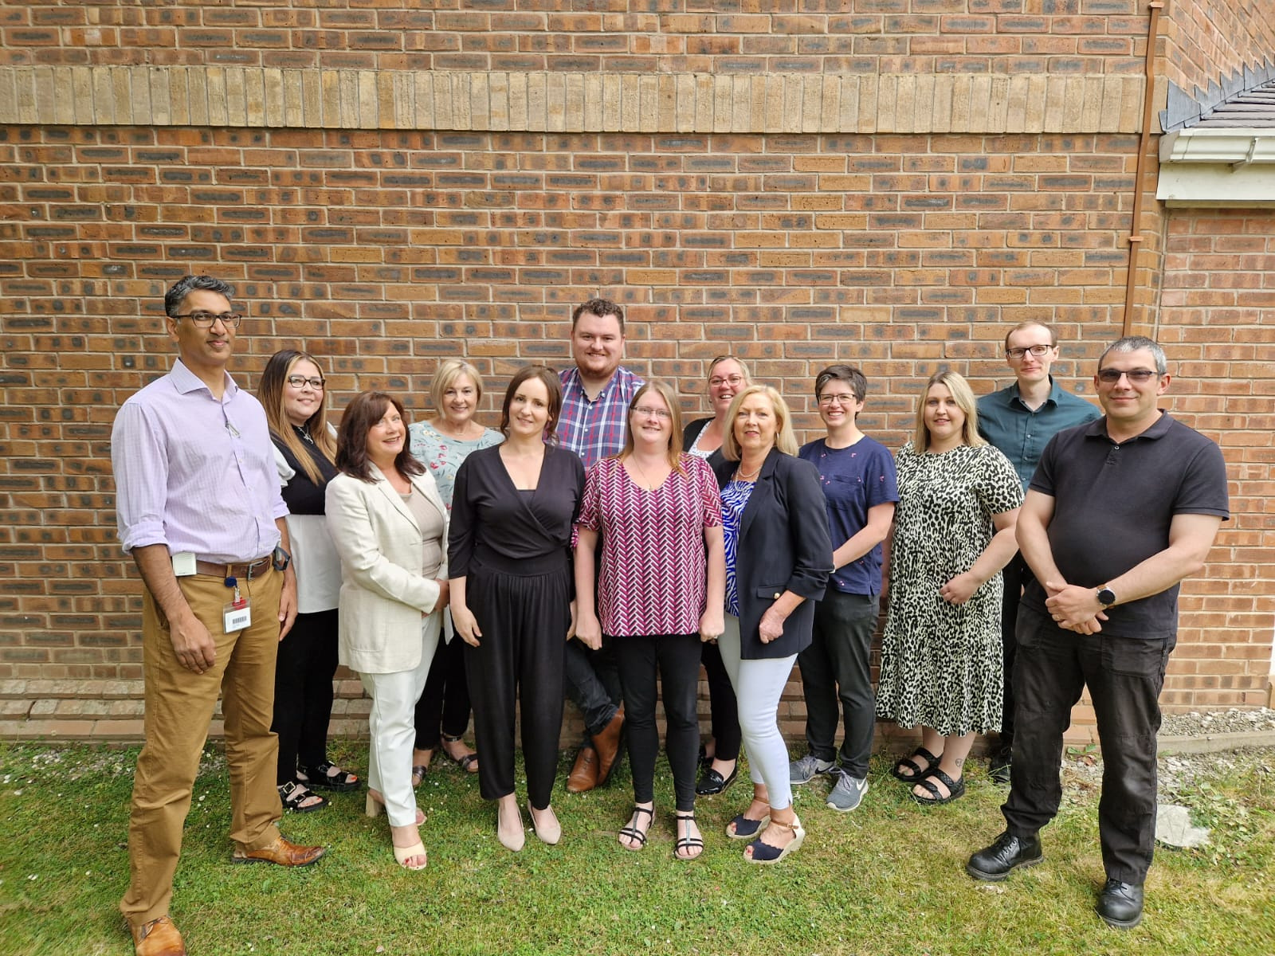
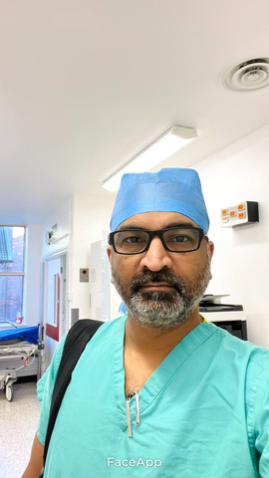
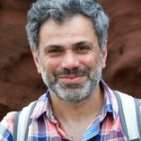
Contact Details
Want to know more, or have any questions? Get in touch with one of our team who will be happy to answer your questions, or direct you to the right person to speak to.
Suzanne Hulmes
Emma Wilson
Andrea Taylor-Clutton
FP Administrator
Suzanne.Hulmes@wales.nhs.uk
Operational Manager
Emma.Wilson4@wales.nhs.uk
Manager
Andrea.Taylor-Clutton@wales.nhs.uk
Dr Chethan Padmanabhaiah
Dr Artur Abelian
Deputy FP Director
Chethan.Padmanabhaiah@wales.nhs.uk
FP Director
Artur.Abelian@Wales.nhs.uk
WRECSAM
MEDED
WREXHAM
Page 19

